Slide 1
SoSECIE Webinar
Welcome to the 2022 System of Systems Engineering Collaborators Information Exchange (SoSECIE)
We will start at 11AM Eastern Time
You can download today’s presentation from the SoSECIE Website:
https://mitre.tahoe.appsembler.com/blog
To add/remove yourself from the email list or suggest a future topic or
speaker, send an email to sosecie@mitre.org

Slide 2
NDIA System of Systems SE Committee
Mission
To provide a forum where government, industry, and academia can share lessons learned, promote best practices, address issues, and advocate systems engineering for Systems of Systems (SoS)
To identify successful strategies for applying systems engineering principles to systems engineering of SoS
Operating Practices
Face to face and virtual SoS Committee meetings are held in conjunction with NDIA SE Division meetings that occur in February, April, June, and August
NDIA SE Division SoS Committee Industry Chairs:
Mr. Rick Poel, Boeing
Ms. Jennie Horne, Raytheon
OSD Liaison:
Dr. Judith Dahmann, MITRE

Slide 3
Simple Rules of Engagement
I have muted all participant lines for this introduction and the briefing.
If you need to contact me during the briefing, send me an e-mail at sosecie@mitre.org.
Download the presentation so you can follow along on your own
We will hold all questions until the end:
I will start with questions submitted online via the CHAT window in Teams.
I will then take questions via telephone; State your name, organization, and question clearly.
If a question requires more discussion, the speaker(s) contact info is in the brief.

Slide 4
Disclaimer
MITRE and the NDIA makes no claims, promises or guarantees about the accuracy, completeness or adequacy of the contents of this presentation and expressly disclaims liability for errors and omissions in its contents.
No warranty of any kind, implied, expressed or statutory, including but not limited to the warranties of non-infringement of third-party rights, title, merchantability, fitness for a particular purpose and freedom from computer virus, is given with respect to the contents of this presentation or its hyperlinks to other Internet resources.
Reference in any presentation to any specific commercial products, processes, or services, or the use of any trade, firm or corporation name is for the information and convenience of the participants and subscribers, and does not constitute endorsement, recommendation, or favoring of any individual company, agency, or organizational entity.

Slide 5
2022 System of Systems Engineering Collaborators Information Exchange Webinars Sponsored by MITRE and NDIA SE Division
March 22, 2022
Mission Engineering Digital Ecosystem
Owen Eslinger
April 5, 2022
Tilting at Windmills: Value Chains, Risk, Opportunity, and the 2021 Texas Electricity Grid Failure
Matthew Hause
April 19, 2022
Feature-based Product Line Engineering in Aerospace and Defense
Charles Krueger
https://www.mitre.org/capabilities/systems-engineering/collaborations/system-of-systems-engineering-collaborators

Slide 6
2022 System of Systems Engineering Collaborators Information Exchange Webinars Sponsored by MITRE and NDIA SE Division
May 3, 2022
Cross-Domain Stakeholder-Alignment in Collaborative SoS – Lego Serious Play as a Boundary Object
Johann Shuetz, Julia Koehlke, and Sebastian Hanna
May 17, 2022
Mission-Level Optimization: A New Method for Designing Successful Systems
Brian Chell
June 14, 2022
Leverage Set-Based Practices to Make Agile Practices More Effective for System-of-Systems Engineering
Brian Kennedy
June 28, 2022
Model Based Systems Engineering in a Digital Environment: Creating a Virtual Testbed for Complex System Architectures
Claudeliah Roze
https://www.mitre.org/capabilities/systems-engineering/collaborations/system-of-systems-engineering-collaborators

Slide 7
Department of Informatics and Telematics

Slide 8
Autonomous Cyber-Physical Systems: System engineering and development
Mara Nikolaidou

Slide 9
Our CPS Engineering Team
Dimosthenis Anagnostopoulos, Professor
Cleopatra Bardaki, Assistant Professor
George Dimitrakopoulos, Associate Professor
Mara Nikolaidou, Professor
Anargyros Tsadimas, Post Doc
George-Dimitrios Kapos, Post Doc
Christos Kotronis, PHD student
Basil Nikolopoulos, PHD student
Elena Politi , PHD student
Giannis Routis, PHD student
Dimitrios Gkoulis, PHD student

Slide 10
Overview – Research Areas
Autonomous aggregators in CPS
Self-controlled context-aware aggregators and Fog/Edge Colonies
Policies and node management middleware
Smart Building Management as a Case Study (EM3, EMC2 project)
Coordination in autonomous CPS
Multi-layer composition of Ephemeral Services
A micro-service event-based architecture for the composer
Smart Farm management as a Case Study (AfarCloud project)
Engineering Cyber-Physical Human Systems (CPHS)
Views of CPHS Design
Human Concerns and the concept of Criticality
Remote Elderly Monitoring System as a Case Study (EMBIOT project)
Funding mainly from EU Projects, QRF (Qatar Research Fund), ELLIDEK (National Greek Research Funding Institute)

Slide 11
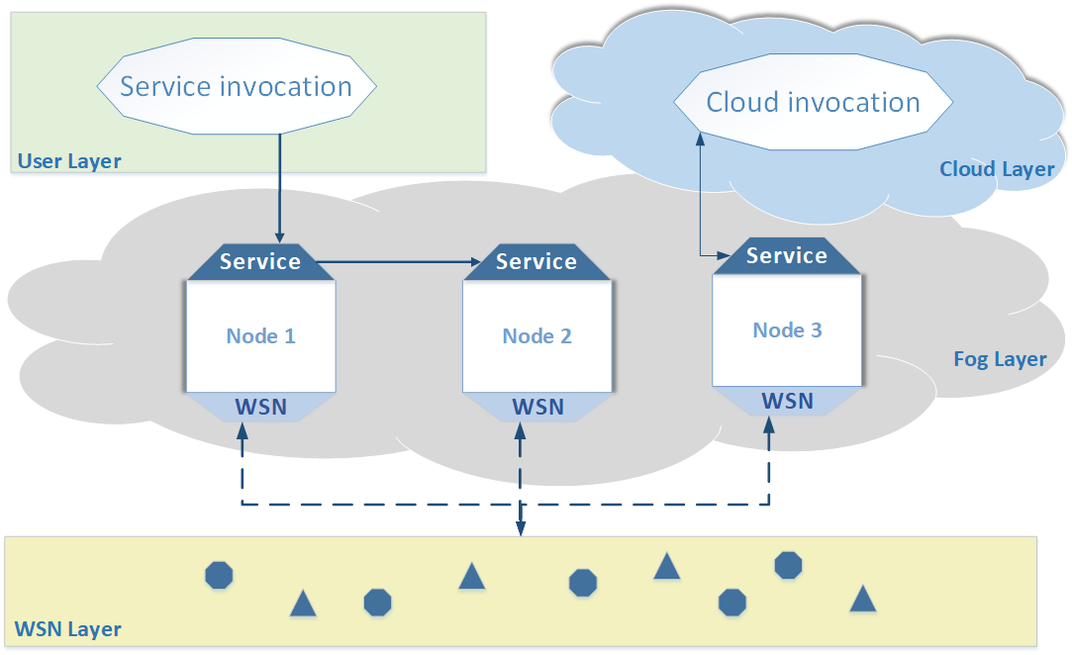
Autonomous aggregators in CPHS
How ”Smart” should aggregators become??
Self-X properties define aggregation nodes autonomy.
Context-awareness enables them to operate without central control → a coordinator
Target
Explore whether such
approach would work
effectively
Test in a
Smart-Managed
Building application

Slide 12
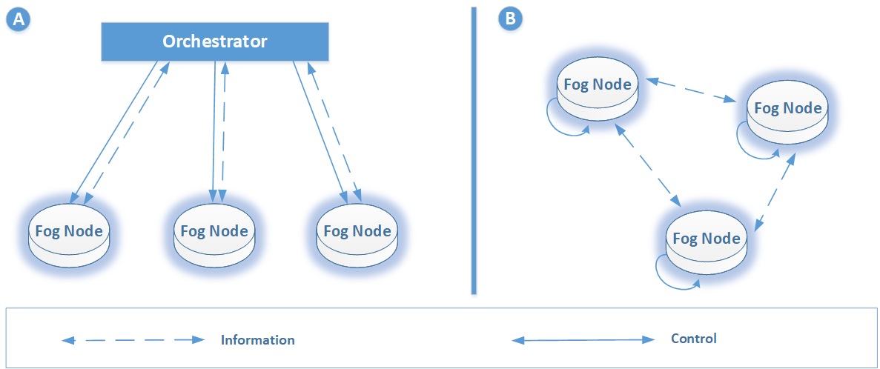
Aggregators Coordination
Centralized vs Decentralized control

Slide 13
The concept of Policies
Context Aware policies prescribe a certain desired behavior for the aggregator.
The collection of the policies enforced by a node comprise the Policy Rulebook
Just like in the real world people have different rules by which they live by, similarly aggregators of the same group do not need to share the same rules.
Policies consist of
A Monitoring Section
A Decision Section
A Resource Section

Slide 14
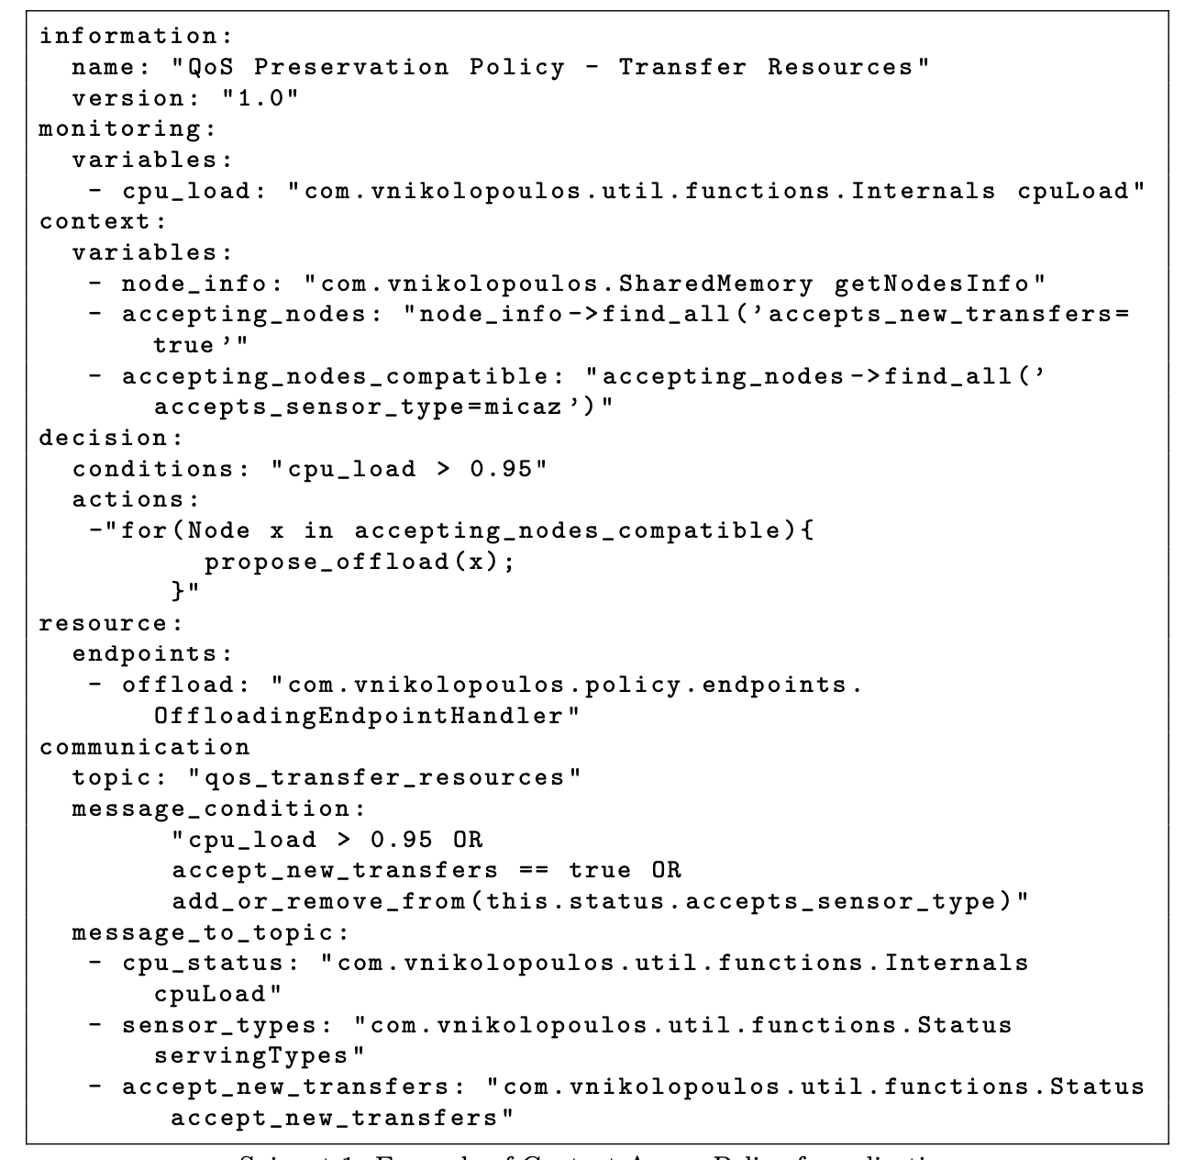
Policy Example
Task
offloading

Slide 15
Context Change
Using a publish-subscribe protocol named ECTORAS
Data shared by Task Offloading Policy

Slide 16
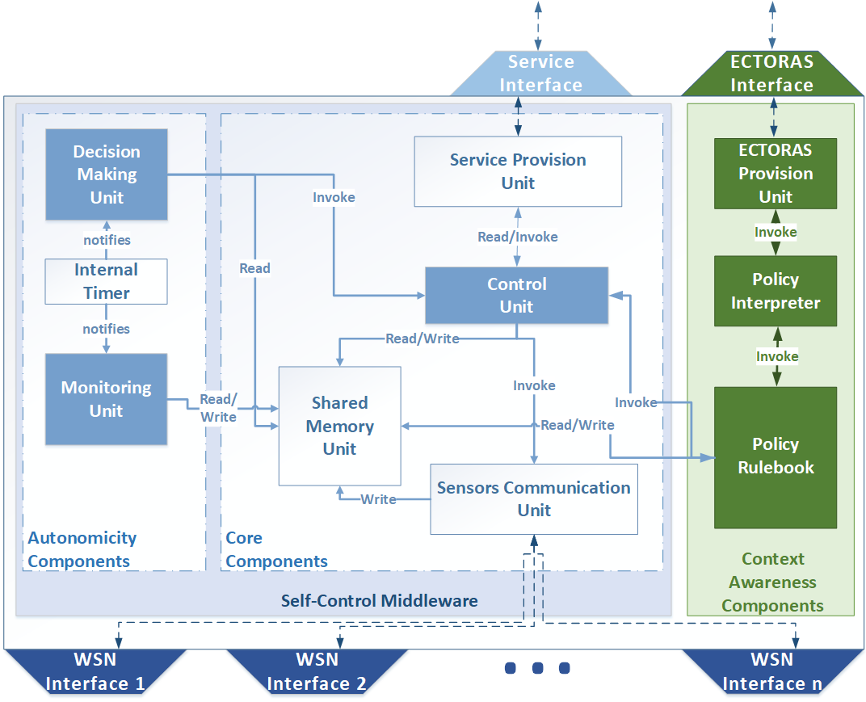
Self-control management middleware

Slide 17
Smart-managed Building: Fire Drills
Target: Explore performance of context-aware vs non context-aware middleware (both developed by our team)
Testbed consists of 30 Nodes
operating on Raspberry Pi 3 revision B units (one node per Raspberry Pi)
handled a minimum of 5 sensors and maximum of 50 sensors of different manufactures, whose presence was dynamic
Communication performed by a mix of local WiFi and Ethernet networks.
Experiment conditions
A “Walk to the nearest exit with no fire” service is executed by all nodes
Nodes handover tasks when too “busy”
Different loads, corresponding to people in the building are generated

Slide 18
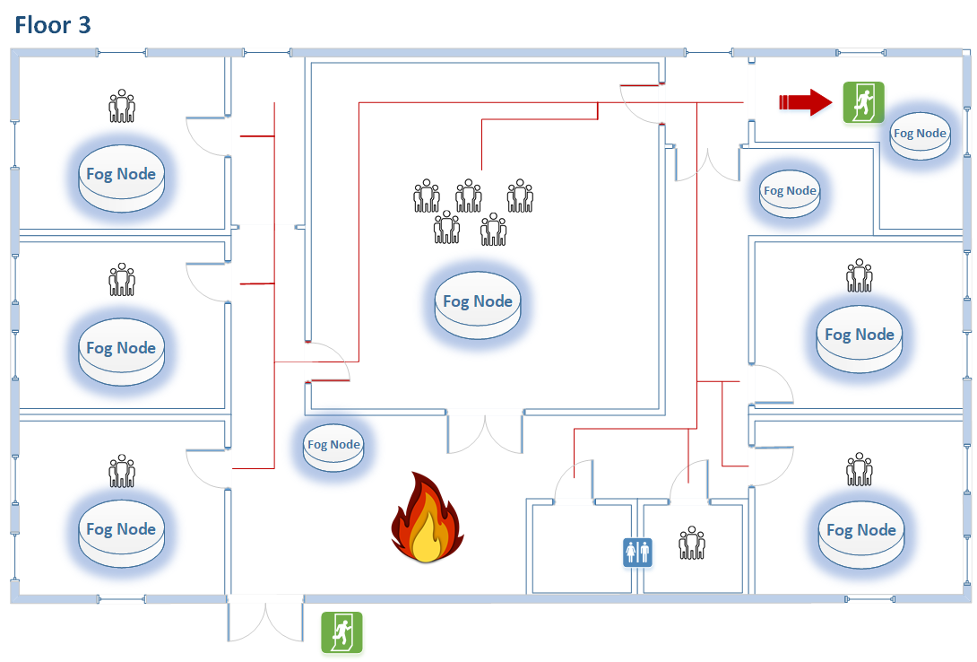
Part of the scenario (third floor)

Slide 19
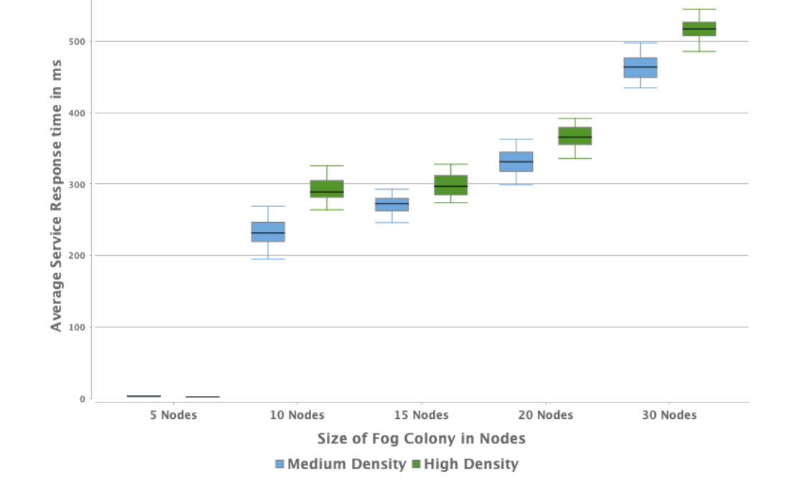
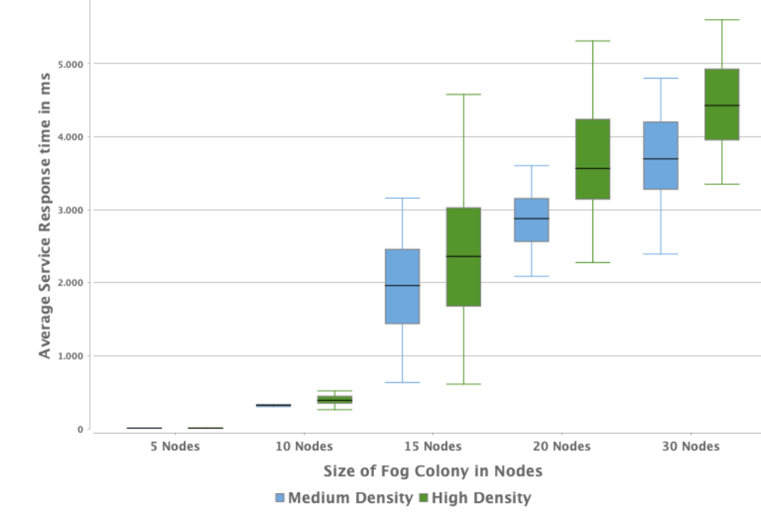
Performance Results
Takeover completion time
Context-aware
Non Context-aware

Slide 20
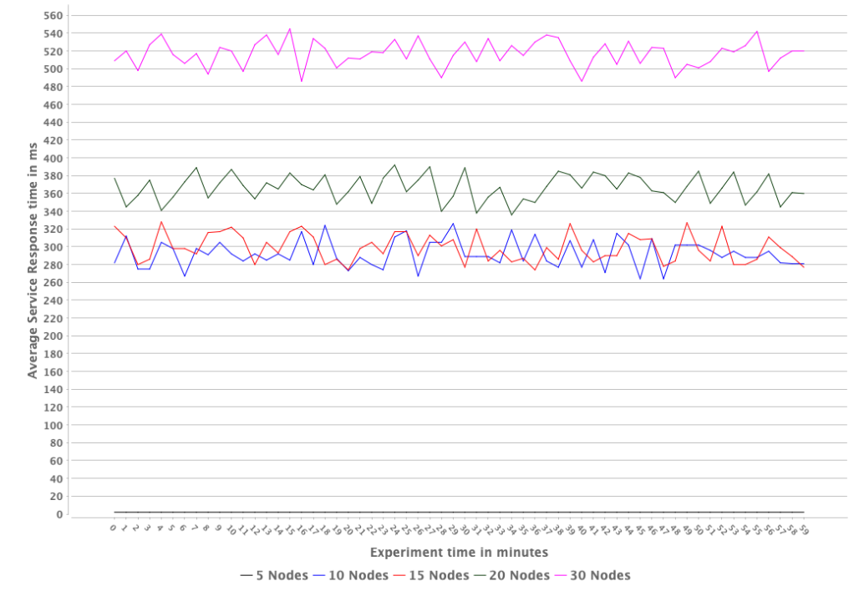
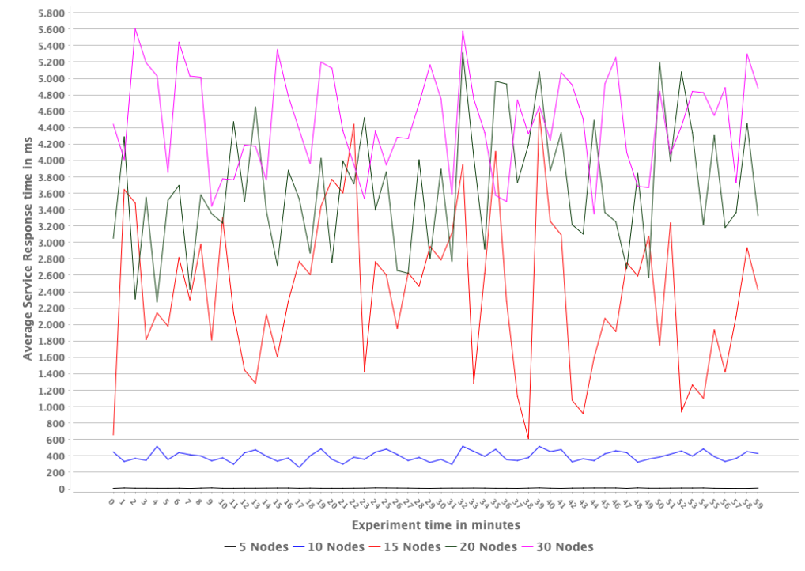
Performance Results
Diversity in Task Offload execution time
Non Context-aware
Context-aware

Slide 21
Results
Context-aware self-control middleware supports better performance and stability in response time
Further test should be performed to cover other KPIs, as energy consumption
Comparison to other approaches (centralized) is of importance
Context Diffusion in Fog Colonies: Exploring Autonomous Fog Node Operation Using ECTORAS, IOT 2022
Enhancing context-awareness in autonomous fog nodes for IoT systems IEEE SERVICES 2019

Slide 22
Coordination in autonomous CPS
Providing “quarantined” services to end-users in a turbulence environment
Ephemeral services
Existence and availability are not quarantined
Life-time could be sort or very sort
The behavior of them may be unpredictable
Composition of Ephemeral Services in CPS
Multi-layer composition of Ephemeral Services
A micro-service event-based architecture for the composer
Smart Farm management as a Case Study (AfarCloud project)
KEY DESIGN ISSUES
Scalability
Modularity
Interoperability
Openness
SOLUTIONS
Microservices
Event-based asynchronous service composition
CHALLENGES
Complicatedness
Unorganized Complexity
Anarchic evolution

Slide 23
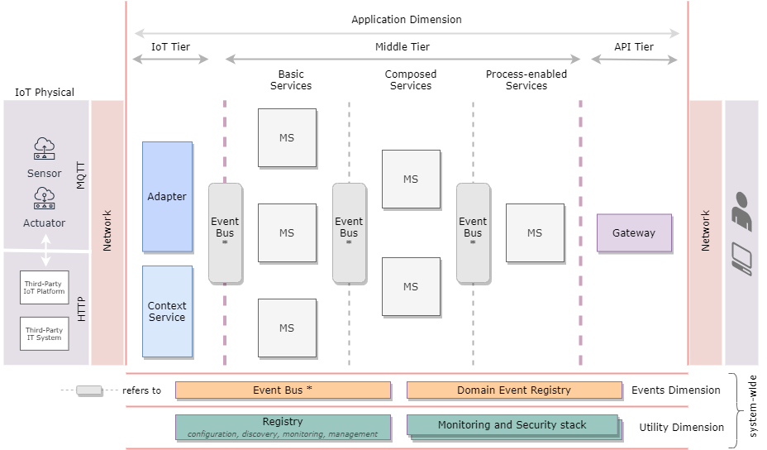
An Event-based Architecture for coordinating autonomous CPSs
Dimensions:
Utility Dimension
Application Dimension
Event Dimension

Slide 24
An Event-based Architecture for coordinating autonomous CPSs
Service composition is performed in multiple layers

Slide 25
An Event-based Architecture for coordinating autonomous CPSs
Based on Microservices
Generic
Distributed
Multi-dimensional
Multi-layered
Event-Based

Slide 26
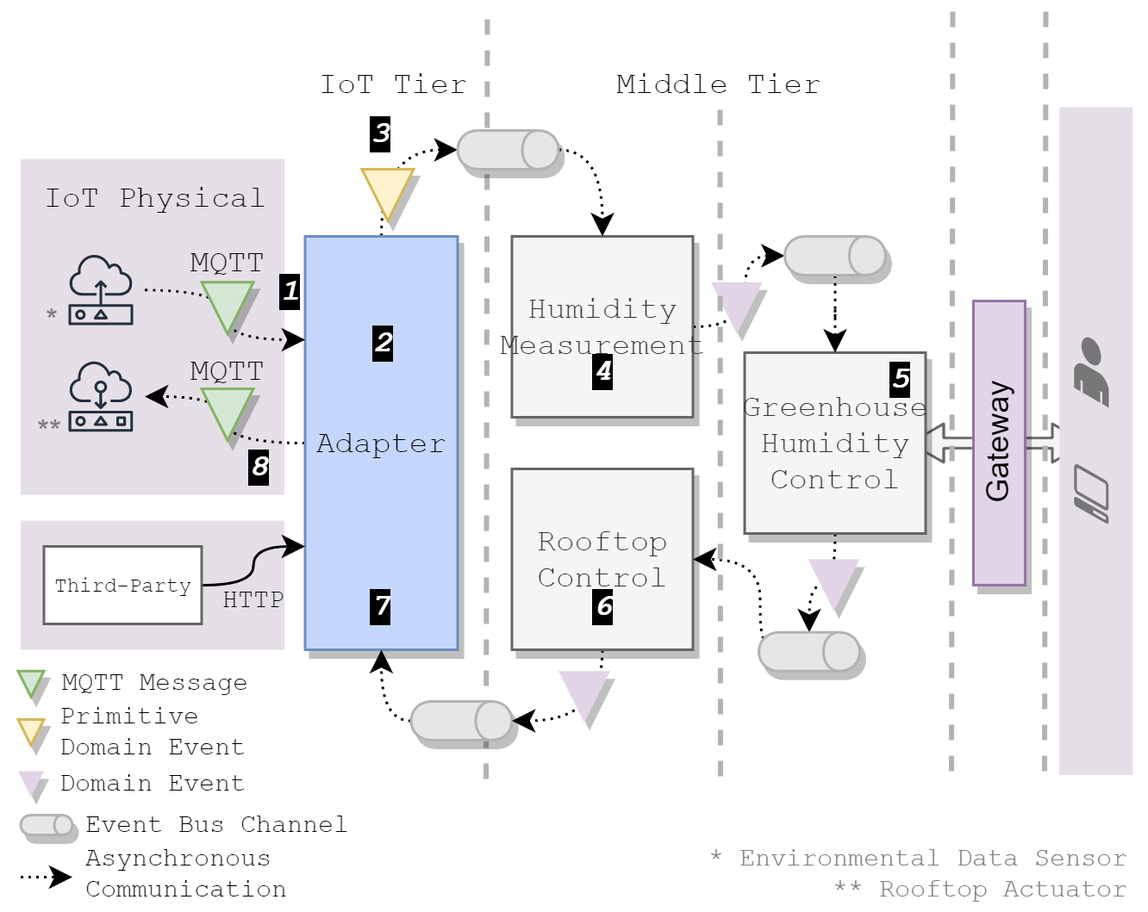
The Case of Smart Farming
Greenhouse Management use case

Slide 27
Greenhouse Management Use Case
Temperature and humidity sensor that may or may not work
Decision on measurement taken on available ones
Fist level event-based service composition
Composite Service
Decision on rooftop management
Second level event-based service composition
Rooftop management
The farmer (user) is involved in this decision
Part of AfarCloud EU project infrastructure

Slide 28
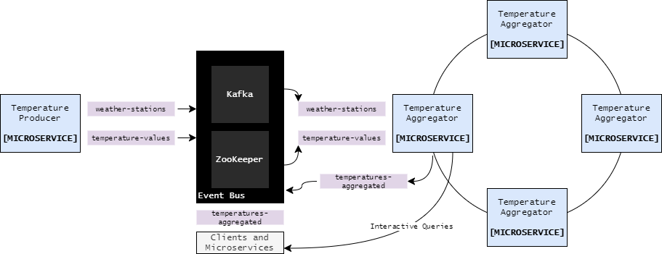
Development stage
First level event-based service composition engine is completed
Presented in IEEE SOSE 2021
An Event-based Microservice Platform for Autonomous Cyber-Physical Systems: the case of Smart Farming

Slide 29
Development stage – work in progress
Process event-based service composition engine
Exploring the utilization of existing event-based process engines
Not supporting the concept of ephemeral service
Available actions for the user should be provided based on the services available
Currently developing a CEP engine based on Kafka.
Complex event processing occurs in predefined time intervals
Input events posses a validity time stamp

Slide 30
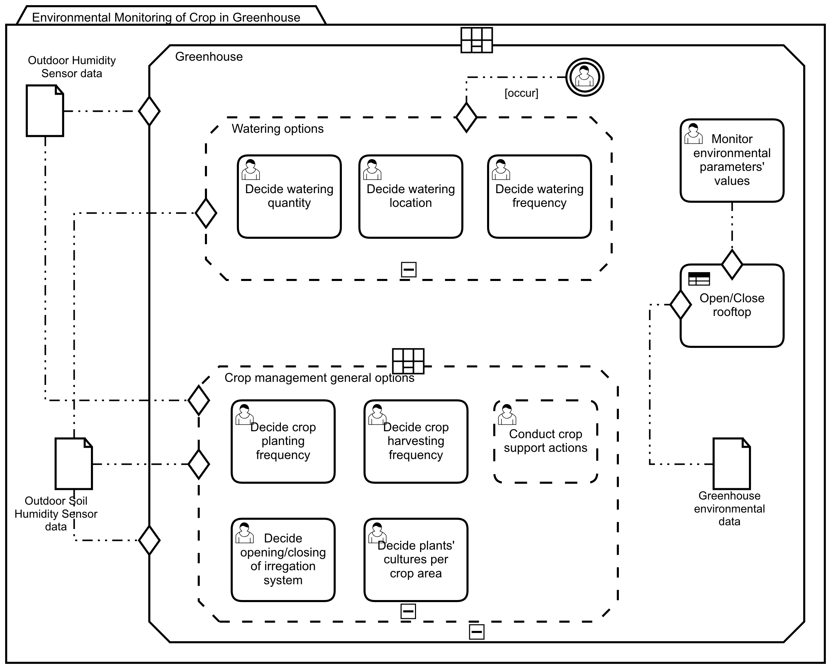
Exploring User Interface
Farmers should be provided with alerts, notifications or prompt to initialize specific actions
Different options on deciding upon rooftop opening or closing
Process description to be communicated with Farmers in CMMN

Slide 31
Results
Work in progress
Emphasis on process events – farmer interaction
Prototype implementation: should be tested in term of correctness and performance

Slide 32
Engineering CPHS
CPHS Design should focus on
How to include people in the CPHS loop
The fact that they behave differently from computers (for example cognition, unpredictability, motivation)
Existing CPHSs design efforts¹²:
Explore human capabilities to enhance their integration in the system
Neglect their incentives, motivating them to act as prescribed
Keep human participant out of the design process, restricting their willingness to participate
1 – S.K. Sowe, E. Simmon, K. Zettsu, F. de Vaulx, I. Bojanova, “Cyber-Physical-Human Systems: Putting People in the Loop”, IEEE IT Pro, Jan-Feb 2016.
2 - S. F. Ochoa, G. Fortino, and G. Di Fatta, “Cyber-physical systems, internet of things and big data,” Future Generat. Comput. Syst., vol. 75, pp. 82–84, 2017

Slide 33
Remote Elderly Monitoring System (REMS)
Enables real-time remote monitoring of vital signs while patients are at home
Signs are monitored by wearable devices (ECGs)
Success relays on the willingness of patient to wear the devices and become part of the CHPS
Basic Home components:
Medical device(s), e.g., sensor → measures vital signs
IoT gateway/Aggregator → collects sensor-generated data
Target
Engage patients in REMS service
Help patients choose a REMS configuration for their Home

Slide 34
Objective
A CPHSs Design Approach:
Consider human motivation factors and their concerns
Include human participants in the design process
Human concerns
Relate to human willingness to actively participate in CPHSs
Might restrict system functionality in practice
Should be transformed into system design requirements
The proposed approach:
facilitates model-based design
integrates the human perspective in a discrete view
supported by standard UML tools (Magic Draw)

Slide 35
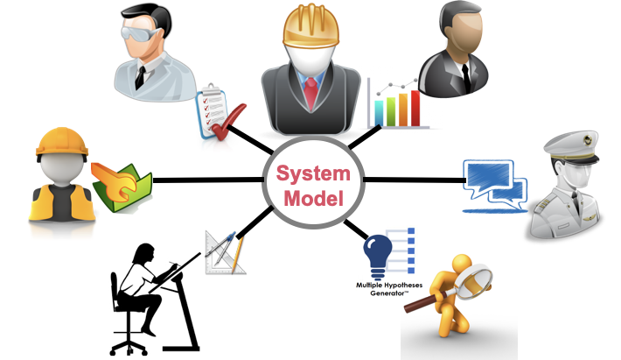
Model-Based Approach for CPHS Design
Facilitate CPHS designers to:
Collaborate with human participants using a discrete view and model their perspective of the system
Incorporate human concerns → translated into system requirements
Introduction of criticality concept
adhere model-based engineering principles
extend existing standards and methodologies (OMG standards, UML profiles)
employ standardized modeling languages (BPMN, SysML)

Slide 36
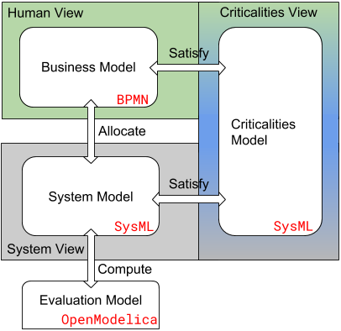
Model-Based Approach for CPHS Design
Perspectives
Human View (served by BPMN)
focusing on human tasks and concerns
System View (served by SysML)
focusing on system components & provided services
Criticalities View
Identify human criticalities and transformed to system criticalities

Slide 37
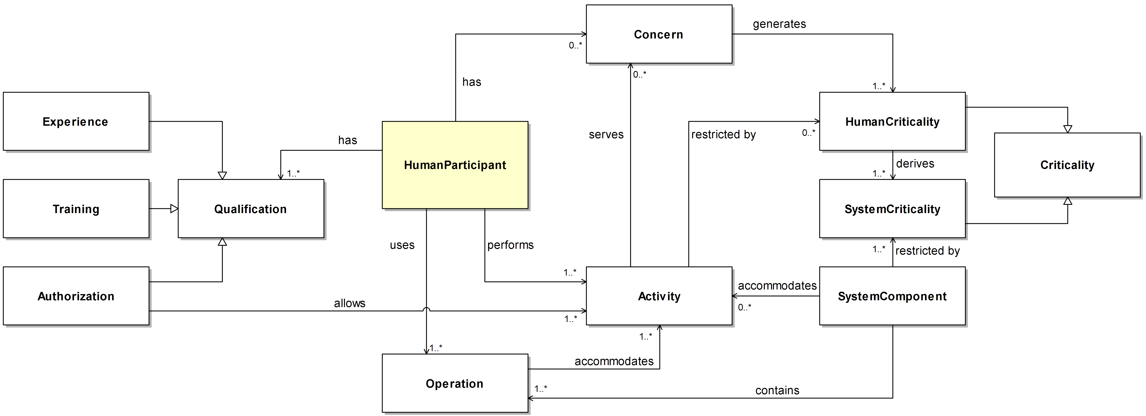
The Concept of Criticality
Aim
transform human concerns into CPHS design requirements
provide quantitative indications in both abstract and detail level
enable the verification of these quantitative requirements
Definition: Extend SysML profile functionality

Slide 38
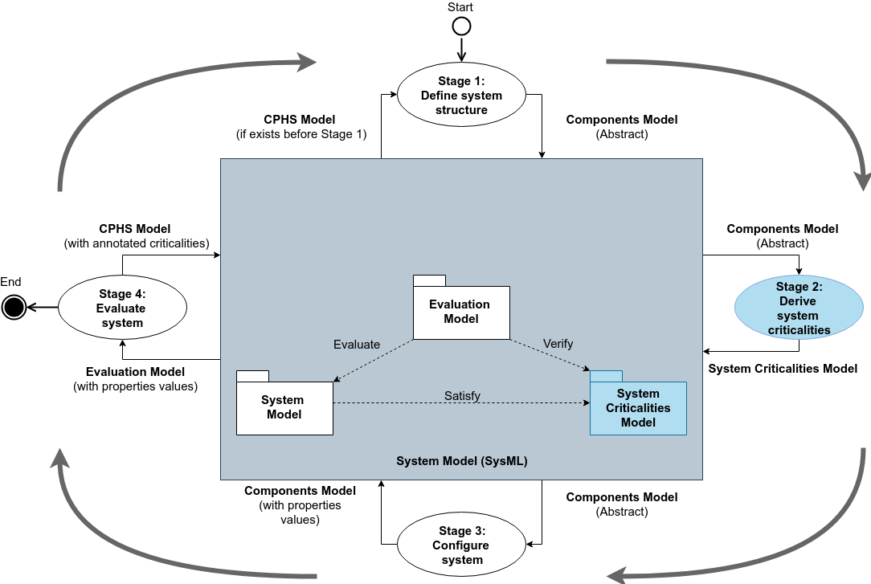
System View

Slide 39
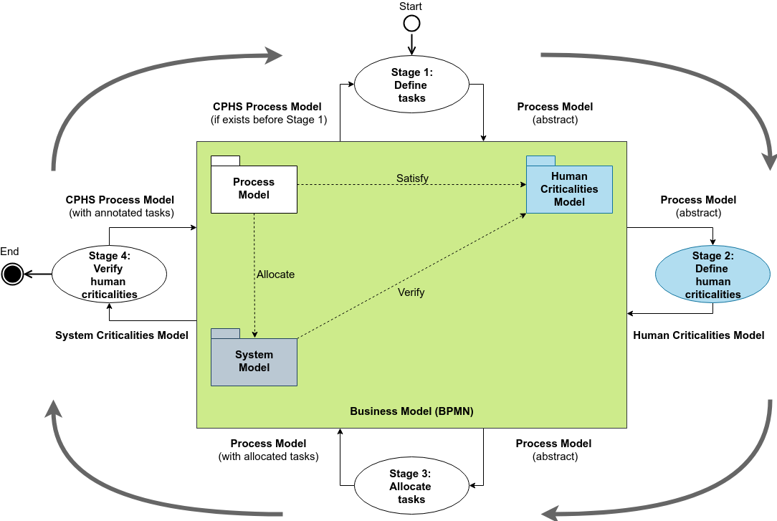
Human View

Slide 40
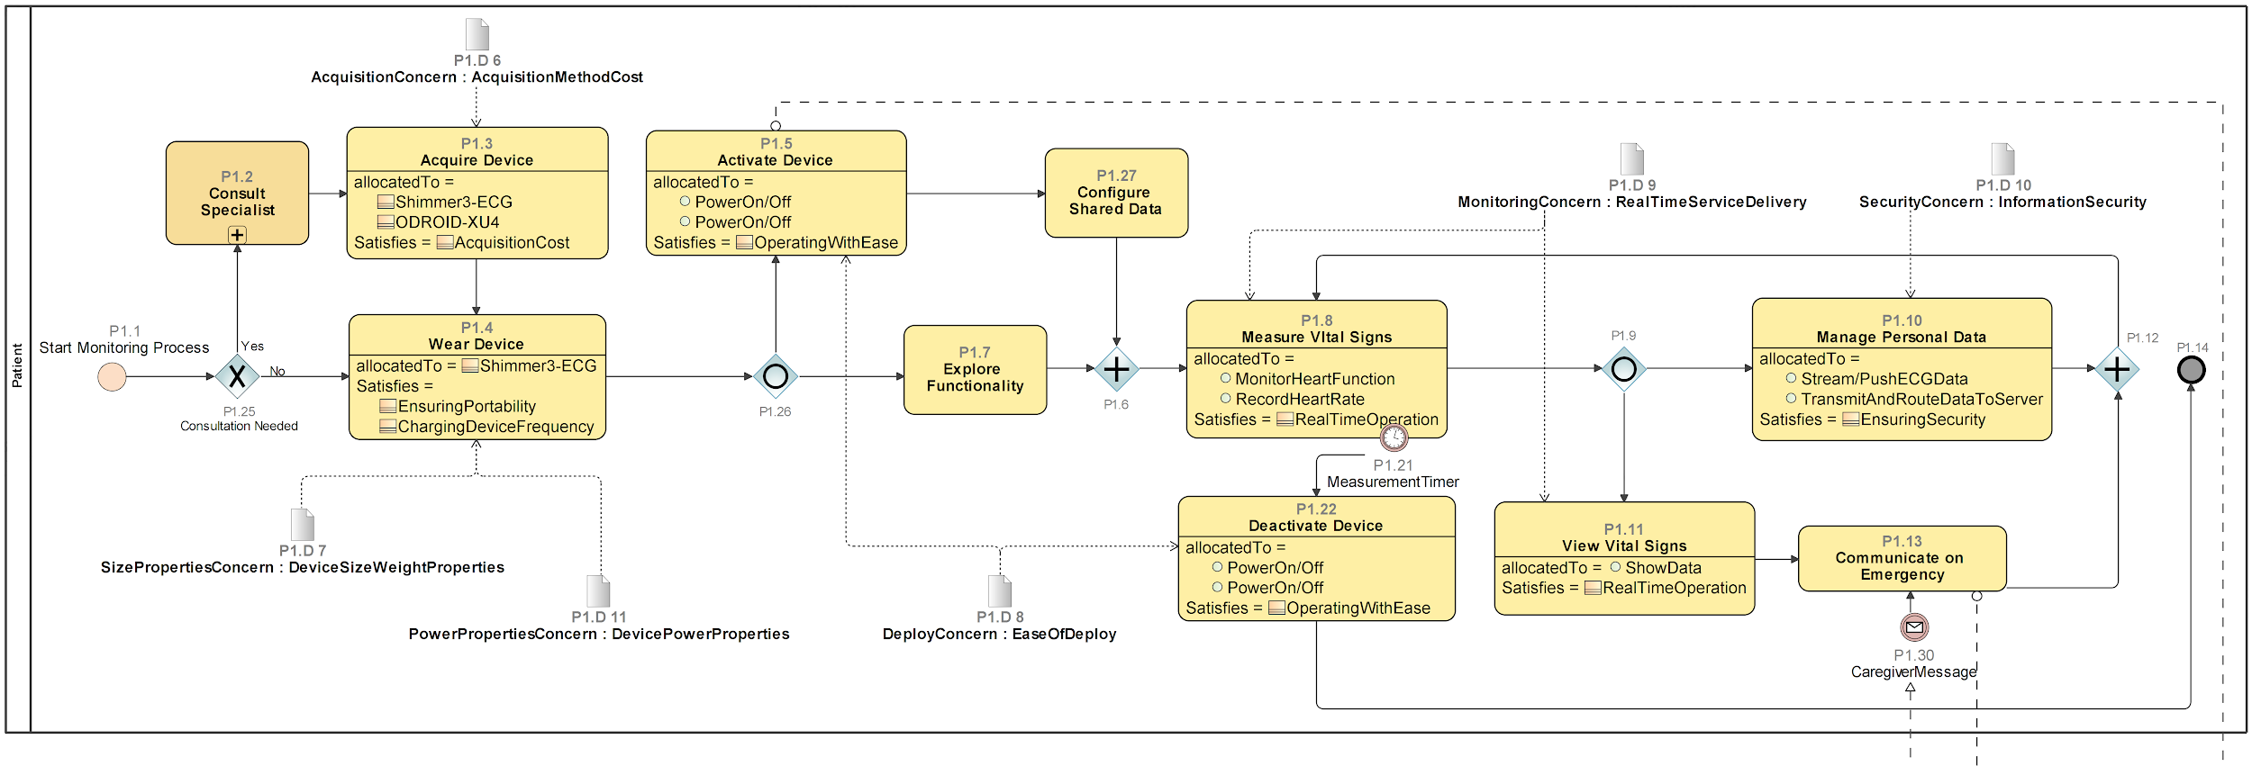
REMS: Identifying Tasks and Patient Concerns
Use of BPMN
Human tasks
relate to different concerns
satisfy specific criticalities

Slide 41
REMS: Identifying Tasks and Patient Concerns
Use of BPMN
Human tasks
relate to different concerns
satisfy specific criticalities

Slide 42
REMS: Define Human Criticalities

Slide 43
REMS: Abstract View of the System

Slide 44
REMS: Allocate Tasks
Human tasks
are allocated to specific system components or functions

Slide 45
REMS: Deriving System Criticalities
1. Create system criticality
(Criticality View)
Performed by the system designer
System criticalities are graded requirements

