Slide 1
SoSECIE Webinar
Welcome to the 2021 System of Systems Engineering Collaborators Information Exchange (SoSECIE)
We will start at 11AM Eastern Time
You can download today’s presentation from the SoSECIE Website:
https://mitre.tahoe.appsembler.com/blog
To add/remove yourself from the email list or suggest a future topic or
speaker, send an email to sosecie@mitre.org

Slide 2
NDIA System of Systems SE Committee
Mission
To provide a forum where government, industry, and academia can share lessons learned, promote best practices, address issues, and advocate systems engineering for Systems of Systems (SoS)
To identify successful strategies for applying systems engineering principles to systems engineering of SoS
Operating Practices
Face to face and virtual SoS Committee meetings are held in conjunction with NDIA SE Division meetings that occur in February, April, June, and August
NDIA SE Division SoS Committee Industry Chairs:
Mr. Rick Poel, Boeing
Ms. Jennie Horne, Raytheon
OSD Liaison:
Dr. Judith Dahmann, MITRE

Slide 3
Simple Rules of Engagement
I have muted all participant lines for this introduction and the briefing.
If you need to contact me during the briefing, send me an e-mail at sosecie@mitre.org.
Download the presentation so you can follow along on your own
We will hold all questions until the end:
I will start with questions submitted online via the CHAT window in Teams.
I will then take questions via telephone; State your name, organization, and question clearly.
If a question requires more discussion, the speaker(s) contact info is in the brief.

Slide 4
Disclaimer
MITRE and the NDIA makes no claims, promises or guarantees about the accuracy, completeness or adequacy of the contents of this presentation and expressly disclaims liability for errors and omissions in its contents.
No warranty of any kind, implied, expressed or statutory, including but not limited to the warranties of non-infringement of third party rights, title, merchantability, fitness for a particular purpose and freedom from computer virus, is given with respect to the contents of this presentation or its hyperlinks to other Internet resources.
Reference in any presentation to any specific commercial products, processes, or services, or the use of any trade, firm or corporation name is for the information and convenience of the participants and subscribers, and does not constitute endorsement, recommendation, or favoring of any individual company, agency, or organizational entity.

Slide 5
2021-2022 System of Systems Engineering Collaborators Information Exchange Webinars Sponsored by MITRE and NDIA SE Division
June 15, 2021
Implementing a Digital Engineering Environment for Mission Engineering
Jason Anderson and Jeffrey Boulware
June 29, 2021
Digital Engineering: From Toolchain to Platform
Dr. Aleksandra Markina-Khusid
July 13, 2021
Developing Meta Systems Architectures for Leading Innovation with Complex Societal and Technical Challenges
Dr. Cihan Dagli
July 27, 2021
Advancements Towards a Digital Approach for Mission Engineering
Todd Shayler and Daniel Browne
August 10, 2021
OUSD R&E: USD(R&E) Mission Engineering (ME) State of Practice
Elmer L. Roman
https://www.mitre.org/capabilities/systems-engineering/collaborations/system-of-systems-engineering-collaborators

Slide 6
Applying an MBSE Approach for Evaluating Shipyard Operations
System of Systems Engineering Collaborators Information Exchange (SoSECIE)
June 1, 2021
Presenter: David Jurkiewicz (djurkiewicz@deloitte.com)
Team: Bell Rueangvivatanakij, akinSeye ogundipe, Adrian holmes,
David Hetherington (System Strategy, Inc. (SSI)), Matthew Hause (System Strategy, Inc. (SSI))

Slide 7
Agenda
Forging the Common Vision
Approach
Critical Success Factors
Context Diagram (OV-1)
Strategic Taxonomy Overview
As-Is State Review
5G State Review
Automated State Review
Conclusions

Slide 8
Forging the Common Vision
Model Based Systems Engineering (MBSE) could help conquer complexity by allowing for the creation of small, focused diagrams that sets of stakeholders can use to negotiate detailed concerns.
Engineering
Internal Software
Application Development
Public Affairs
IT
Production
Management
Legal
Facilities
Operations Management
Supply
Human Resources
The large number of detail diagrams are integrated into a cohesive whole by the underlying model.

Slide 9
MBSE Notional Naval Shipyard Operations Approach
The following is a high-level review of the Team’s methodology, challenges, and solution as we constructed operations for a notional “Shipyard of the Future.”
Methodology
Challenges
Solution
Conducted workings sessions to review current policies, practices, and procedures
Annotated real life experiences with systematic inefficiencies and modeled areas of potential improvement
Built a model to visualize the As-Is State and developed an iterative approach to incorporate new technology and processes
Implemented an agile framework to show issue resolution and recyclability for solution development
Our Challenges:
Broad problem set with abstract processes
New members to modeling and enterprise architecture
Abundance of opportunity
Challenges in a Shipyard Environment:
Potential setbacks with schedule and mission due to maintenance and logistics
Costs
Maintenance Prioritization
Disparate Systems
Established the As-Is State to understand current policies, practices, and procedures
Developed iterative and recyclable approach for the Future State to include:
Incorporation of a 5G Network
Fully Automated To-Be State

Slide 10
Critical Success Factors
There are three distinct factors that drove the utility of the Shipyard of the Future Model.
.
Establish a baseline by modeling the As-Is State and evaluating for process inefficiencies
Analyze best practices and current work to identify technological improvements and develop an interim state
Develop To-Be State, incorporate recommendations
Created a depiction of the As-Is State and determined a focus area for Future State modeling efforts. Critical success was to have a holistic view of a notional public shipyard.
Discovered inefficiencies within the work initiation process for unplanned maintenance. Critical success was to model an unplanned maintenance cycle and evaluate the scenario to reduce ship availability time.
Developed a phased technological enhancement approach to improve unplanned maintenance. Critical success was to generate a framework for technological enhancements to reduce extended ship availability time.

Slide 11
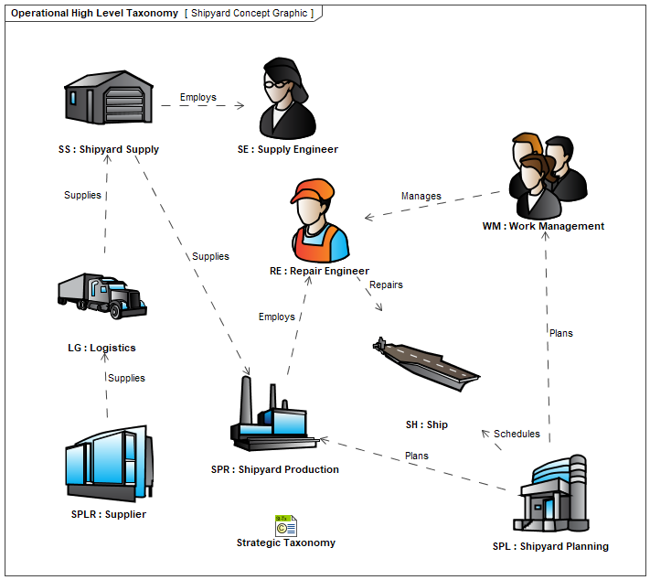
Context Diagram (OV-1)
An OV-1 Diagram was constructed to provide context to the notional current state’s personnel, processes, and technology.

Slide 12
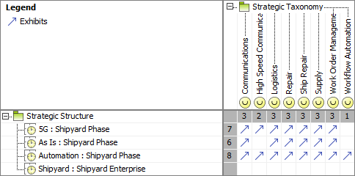
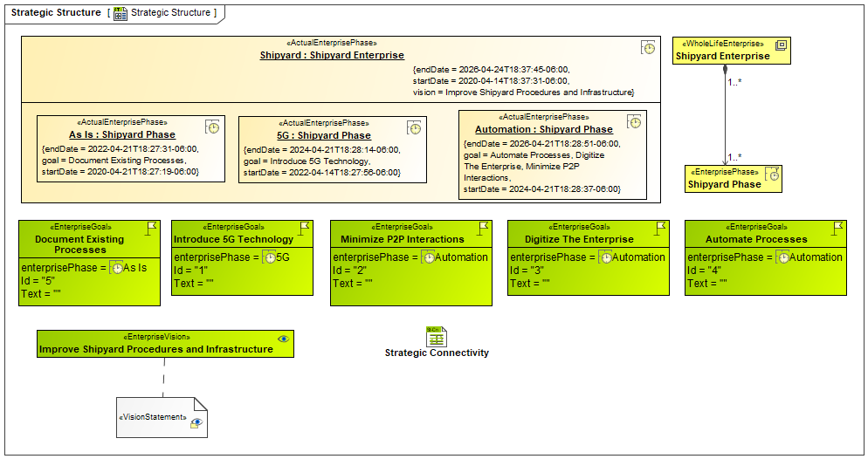
Strategic Taxonomy Overview
A strategic taxonomy was established to outline the model’s capabilities, the Team’s goals, and enablement of an notional integrated master schedule.
Capabilities
Goals
Schedule

Slide 13
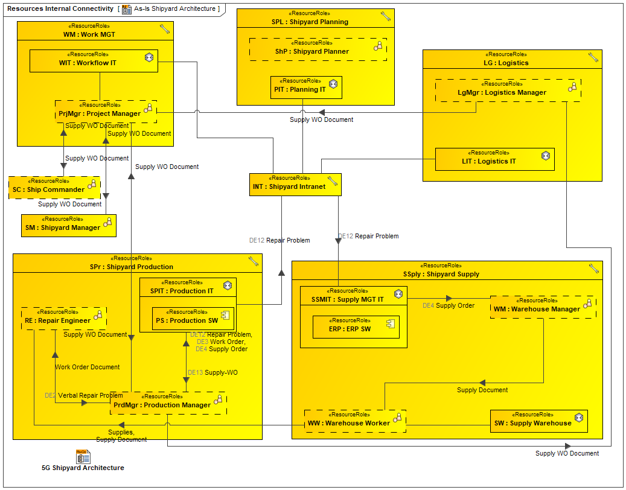
As-Is State Review
Articulates the notional current state that assumed a mostly manual document or information exchange and processing.

Slide 14
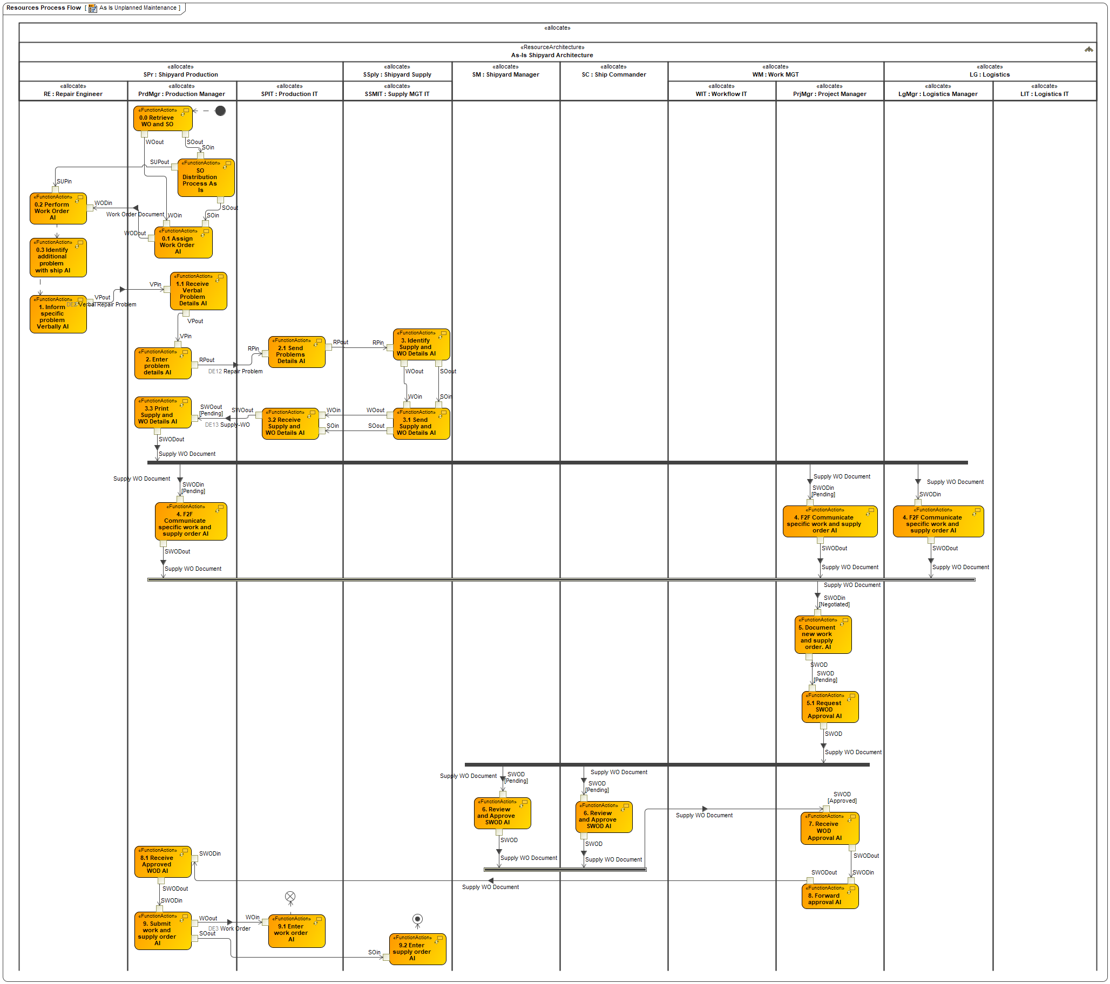
As-Is State Review - Unplanned Maintenance Process Flow
Articulates the notional current state that assumed a mostly manual document or information exchange and processing.

Slide 15
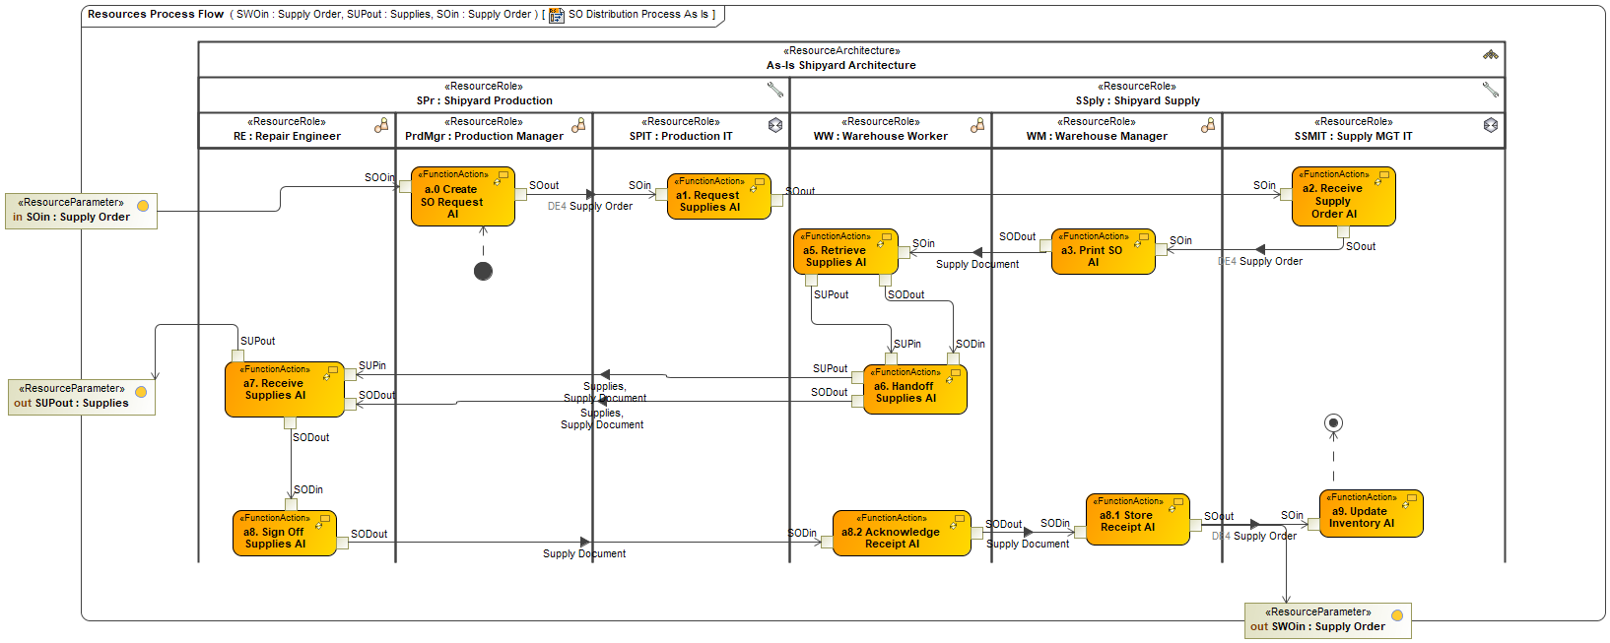
As-Is State Review - Resource Process Flow
Articulates the notional current state that assumed a mostly manual document or information exchange and processing.

Slide 16
Changes Between As-Is to 5G
Analyzed an incremental step or phase to transition closer to the Shipyard of the Future.
 | As-Is | 5G
Document Unplanned Maintenance | Physical meeting between repair engineer and production manager. Paper-based documentation. | Problem documented on 5G device and passed to manager. Physical meeting if necessary.
Assign Work Order | Manually calculated and assigned by production manager. Paper-based order. | Manually calculated and assigned. Work order sent to 5G device.
Supply order Distribution | Manually assigned by WH manager. Paper-based supply order physically signed and stored. | Manually assigned by WH manager. Supply order sent to 5G device and electronically signed.
Agree Unplanned Maintenance | Paper document work order issued. F2F meetings required and physical sign-off of work authorization. | Electronic work order issued. F2F meetings required and physical sign-off of work authorization.
Request Supply Order | Paper document supply order issued and hand carried by repair engineer. | Electronic supply order to sent to WH when job manually assigned to repair engineer.

Slide 17
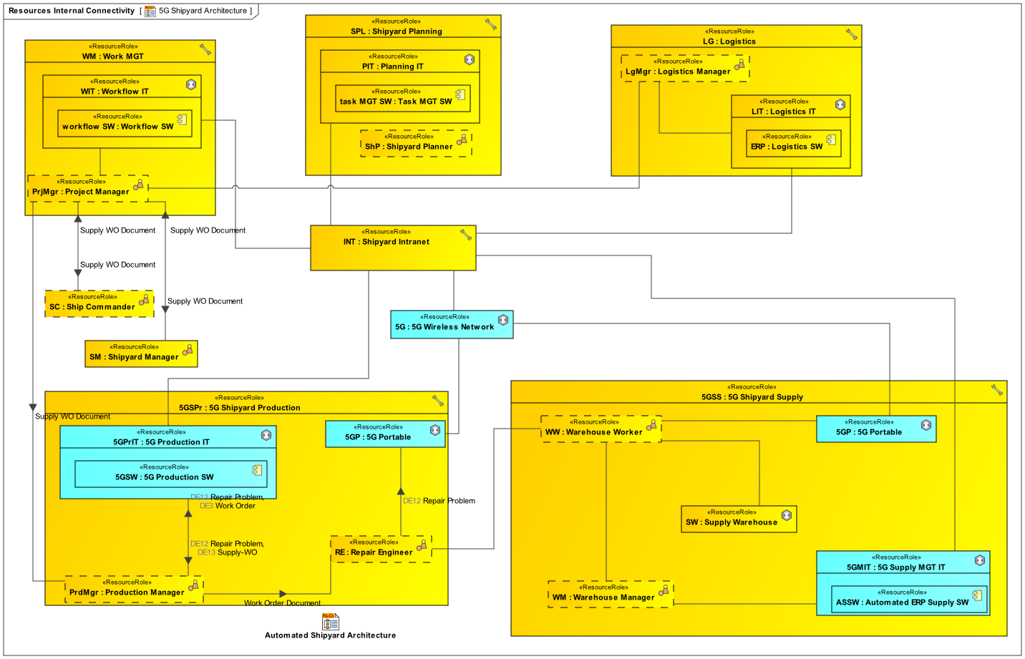
5G State Review
Introduced a notional 5G network and initial opportunities for digitization (5G portables), and depicted the foundation for the implementation of automated workflow.
As-Is
Adding 5G

Slide 18
5G State Review - Unplanned Maintenance Process Flow
Introduced a notional 5G network and initial opportunities for digitization (5G portables), and depicted the foundation for the implementation of automated workflow.
As-Is
Adding 5G

Slide 19
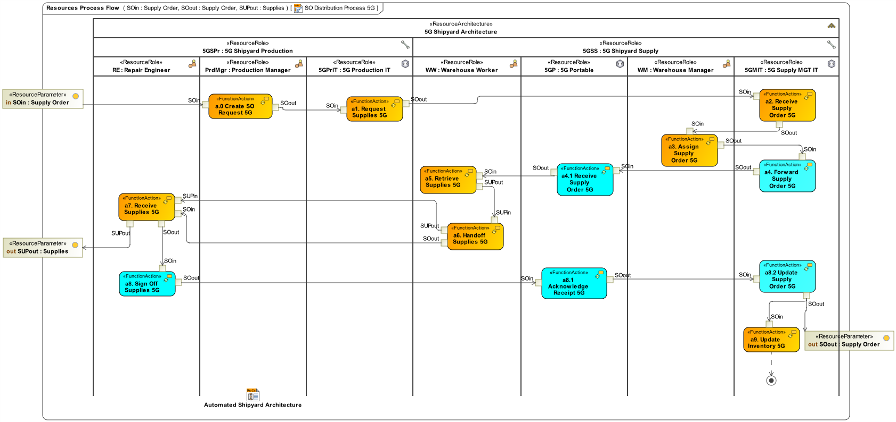
5G State Review - Resource Process Flow
Introduced a notional 5G network and initial opportunities for digitization (5G portables), and depicted the foundation for the implementation of automated workflow.
As-Is
Adding 5G

Slide 20
Changes Between 5G to Automated
Analyzed a third incremental step to get closer to the Shipyard of the Future.
 | As- Is | 5G | Automated
Document Unplanned Maintenance | Physical meeting between repair engineer and production manager. Paper-based documentation. | Problem documented on 5G device and passed to manager. Physical meeting if necessary. | Same.
Assign Work Order | Manually calculated and assigned by production manager. Paper-based order. | Manually calculated and assigned. Work order sent to 5G device. | Automatically calculated based on availability of personnel and parts. Work order sent to 5G device.
Supply order Distribution | Manually assigned by WH manager. Paper-based supply order physically signed and stored. | Manually assigned by WH manager. Supply order sent to 5G device and electronically signed. | Automatically assigned by supply IT SW. Supply order sent to 5G device and electronically signed.
Agree Unplanned Maintenance | Paper document work order issued. F2F meetings required and physical sign-off of work authorization. | Electronic work order issued. F2F meetings required and physical sign-off of work authorization. | Electronic work order issued. Initial approval via virtual meeting. Final approval physical sign-off of work authorization.
Request Supply Order | Paper document supply order issued and hand carried by repair engineer. | Electronic supply order to sent to WH when job manually assigned to repair engineer. | Electronic supply order sent automatically by system.

Slide 21
Automated State Review
Exhibits how enterprise digital transformation could minimize person-to-person and physical exchanges, and prioritize human resources on more meaningful efforts.
As-Is
Adding 5G
Adding Automation

Slide 22
Automated State Review - Unplanned Maintenance Process Flow
Exhibits how enterprise digital transformation could minimize person-to-person and physical exchanges, and prioritize human resources on more meaningful efforts.
As-Is
Adding 5G
Adding Automation

Slide 23
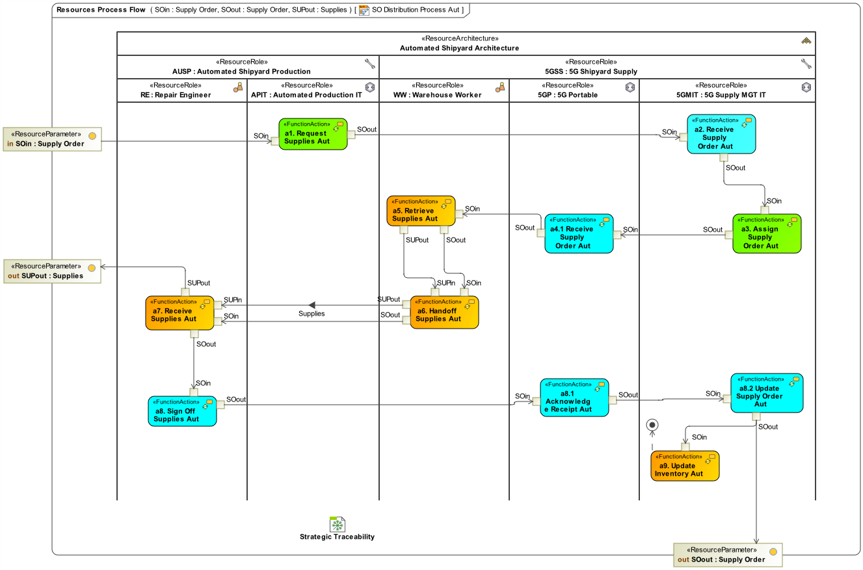
Automated State Review - Resource Process Flow
Exhibits how enterprise digital transformation could minimize person-to-person and physical exchanges, and prioritize human resources on more meaningful efforts.
As-Is
Adding 5G
Adding Automation

Slide 24
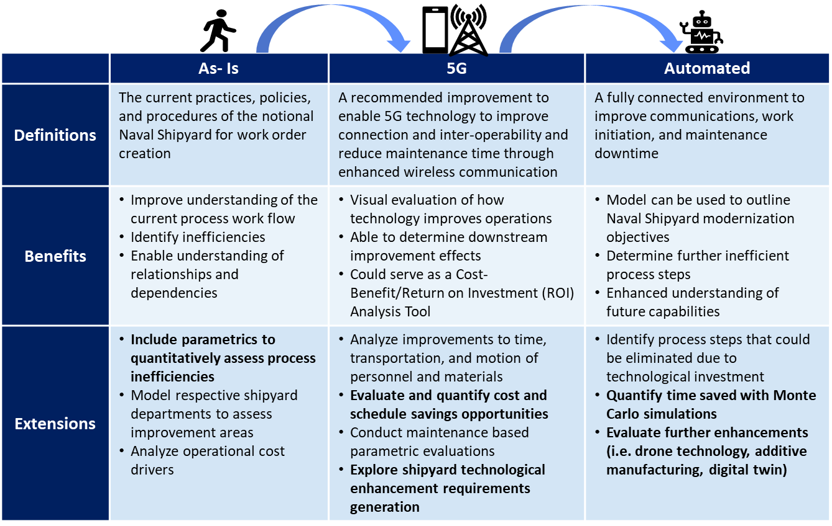
Conclusions to an Iterative Change Approach
Benefits of the Phased Approach and Areas of Further Study.

Slide 25
About Deloitte
As used in this document, “Deloitte” means Deloitte Consulting LLP, a subsidiary of Deloitte LLP. Please see www.deloitte.com/us/about for a detailed description of our legal structure. Certain services may not be available to attest clients under the rules and regulations of public accounting. This communication contains general information only, and none of Deloitte Touche Tohmatsu Limited, its member firms or their related entities (collectively, the "Deloitte Network"), is, by means of this communication, rendering professional advice or services. Before making any decisions or taking any action that may affect your finances, or your business, you should consult a qualified professional adviser. No entity in the Deloitte Network shall be responsible for any loss whatsoever sustained by any person who relies on this communication.
Copyright © 2021 Deloitte Consulting LLP. All rights reserved.

