Slide 1
SoSECIE Webinar
Welcome to the 2021 System of Systems Engineering Collaborators Information Exchange (SoSECIE)
We will start at 11AM Eastern Time
You can download today’s presentation from the SoSECIE Website:
https://mitre.tahoe.appsembler.com/blog
To add/remove yourself from the email list or suggest a future topic or
speaker, send an email to sosecie@mitre.org

Slide 2
NDIA System of Systems SE Committee
Mission
To provide a forum where government, industry, and academia can share lessons learned, promote best practices, address issues, and advocate systems engineering for Systems of Systems (SoS)
To identify successful strategies for applying systems engineering principles to systems engineering of SoS
Operating Practices
Face to face and virtual SoS Committee meetings are held in conjunction with NDIA SE Division meetings that occur in February, April, June, and August
NDIA SE Division SoS Committee Industry Chairs:
Mr. Rick Poel, Boeing
Ms. Jennie Horne, Raytheon
OSD Liaison:
Dr. Judith Dahmann, MITRE

Slide 3
Simple Rules of Engagement
I have muted all participant lines for this introduction and the briefing.
If you need to contact me during the briefing, send me an e-mail at sosecie@mitre.org.
Download the presentation so you can follow along on your own
We will hold all questions until the end:
I will start with questions submitted online via the CHAT window in Teams.
I will then take questions via telephone; State your name, organization, and question clearly.
If a question requires more discussion, the speaker(s) contact info is in the brief.

Slide 4
Disclaimer
MITRE and the NDIA makes no claims, promises or guarantees about the accuracy, completeness or adequacy of the contents of this presentation and expressly disclaims liability for errors and omissions in its contents.
No warranty of any kind, implied, expressed or statutory, including but not limited to the warranties of non-infringement of third-party rights, title, merchantability, fitness for a particular purpose and freedom from computer virus, is given with respect to the contents of this presentation or its hyperlinks to other Internet resources.
Reference in any presentation to any specific commercial products, processes, or services, or the use of any trade, firm or corporation name is for the information and convenience of the participants and subscribers, and does not constitute endorsement, recommendation, or favoring of any individual company, agency, or organizational entity.

Slide 5
2022 System of Systems Engineering Collaborators Information Exchange Webinars Sponsored by MITRE and NDIA SE Division
January 11, 2022
Approach for Complex Deterministic and Nondeterministic Systems (ACDANS)
Dr. Paul C. Hershey
January 25, 2022
Applying SoSE in Healthcare: the case for a soft systems methodology approach to Digital-first Primary Care
Iqra Shahzad, Melanie King, and Michael Henshaw
February 8, 2022
Empowering Adaptive Human Autonomy Collaboration (DUAL) with Artificial Intelligence
Dr. Mark Chattington
https://www.mitre.org/capabilities/systems-engineering/collaborations/system-of-systems-engineering-collaborators

Slide 6
2022 System of Systems Engineering Collaborators Information Exchange Webinars Sponsored by MITRE and NDIA SE Division
February 22, 2022
System of Systems Engineering Conference (SoSE) and Industry Perspectives and the Role of SoSE: INCOSE and IEEE Collaborations
Paul Hershey, Garry Roedler, and Mo Jamshidi
March 8, 2022
An Event-based Microservice Platform for Autonomous Cyber-Physical Systems: the case of Smart Farming
Mara Nikolaidou
May 3, 2022
Cross-Domain Stakeholder-Alignment in Collaborative SoS – Lego Serious Play as a Boundary Object
Johann Shuetz, Julia Koehlke, and Sebastian Hanna
https://www.mitre.org/capabilities/systems-engineering/collaborations/system-of-systems-engineering-collaborators

Slide 7
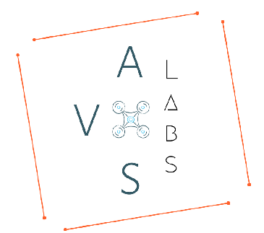
A heterogeneous autonomous collaborative system for powerline inspection using human-robotic teaming
Srikanth Vemula, Jovany Avila, & Dr. Michael Frye
Autonomous Vehicle System laboratories (AVS Labs)
University of The Incarnate Word, San Antonio, Texas

Slide 8
Agenda
Overview of AVS Labs
Problem Statement
Proposed System
Unmanned Ground Vehicle System
Unmanned Aerial Vehicle System
Results
Future Work

Slide 9
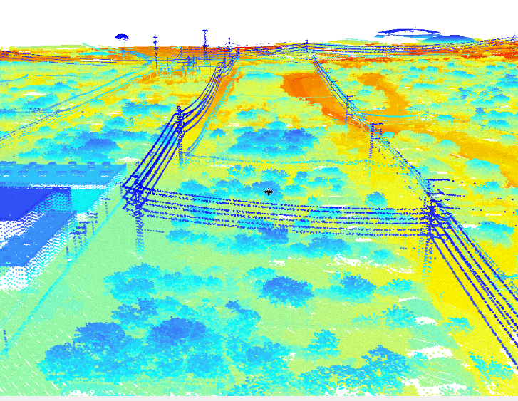
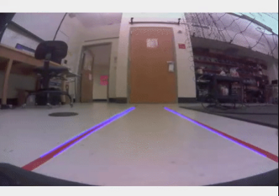
Overview of AVS Labs
Guidance Navigation and Controls Lab
New Swarm Lab with 12 Drones, 1000sqf
New Autonomous Car track with 5 Cars, 700sqf
New UGV Lab with 10 vehicles, 400sqf
Computational Intelligence Lab
Machine, Deep, and Reinforcement Learning
Object Detection and Classification
Reasoning, Prediction, and Control
Synthetic Environments Lab
LiDAR and IR Sensor Fusion
3D Mapping
Digital Twins
Virtual Simulations

Slide 10
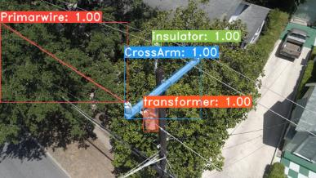
Problem Statement
Hovering of drones at low altitude
Cannot inspect longer distances, due to its limited endurance
Limited battery power capacities on the drones
Challenging to perform more extended inspection missions
Expensive task to establish several ground stations for the communication to the drone and is not practical
S. Vemula and M. Frye, "Real-Time Powerline Detection System for an Unmanned Aircraft System," 2020 IEEE International Conference on Systems, Man, and Cybernetics (SMC), 2020, pp. 4493-4497, doi: 10.1109/SMC42975.2020.9283354.
Notes:
even though various use cases show evidence ofusing drones in the inspection. Some obstacles prevent thewide adaption of usage of drones in powerline Inspection;such conditions involves hovering of drones at low altitudefor closer inspection. In those situations, small-scale drones
bring more versatility in obtaining accurate detection duringthe inspection. However, even in small drones, there is limitedendurance and cannot inspect longer distances. Also, due to thelimited battery power capacities on the drones, it is challengingto perform more extended inspection missions. In order toestablish several ground stations for the communication tothe drone, turns out to be an expensive task and is notpractical. There is also a very high chance of experiencingthe communication loss between the ground and the dronewhile performing the inspection.

Slide 11
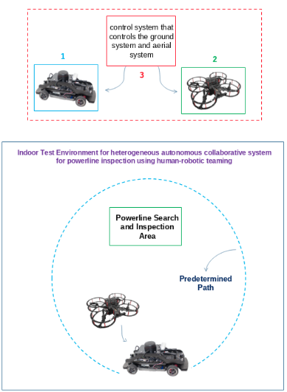
Proposed System
Unmanned Ground Vehicle (UGV) system that will take tasks from the human control system to drive through the path determined
Unmanned Aerial Vehicle (UAV) system that conducts the powerline search and inspection within a specified range
A control system operated by human that takes cares of the UGV & UAV functionality
Proposed Collaborative human-robotic teaming System

Slide 12
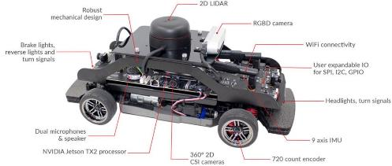
Unmanned Ground Vehicle (UGV)
QCar was used as UGV system
Q-learning is used to train the model
By providing a state and action scenario using exploiting and exploring techniques by updating the table and assigning the reward based on the agent’s actions
Flowchart for QCar self-driving mechanism for UGV
Notes:
Q-learning is used to train the model
By providing a state and action scenario using exploiting and exploring techniques by updating the table and assigning the reward based on the agent’s actions.

Slide 13
Unmanned Aerial Vehicle (UAV)
Detect QCar using Neural Network
Takeoff
Aerial Scan
Detect & Follow powerline
Return to base
Land
Flowchart for QDrone UAV.

Slide 14
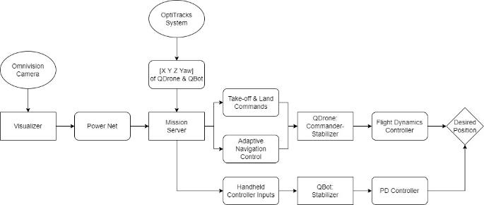
Human Autonomy Teaming (HAT) Inspection Model
UGV is controlled manually
UAV & UGV are both tracked using OptiTracks System
UAV follows to utility pole models
Upon detection, UAV simulates an inspection of the pole
Repeats until user defined max is achieved
Returns home and land
Workflow for team inspection system.

Slide 15
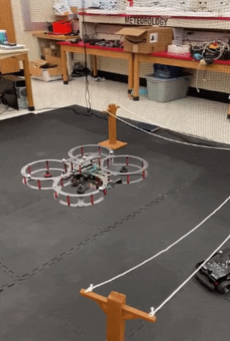
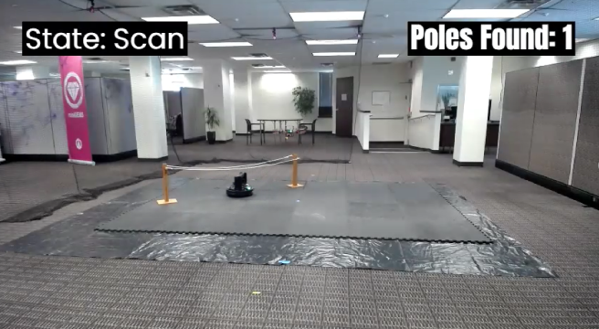
Results
A heterogenous autonomous collaborative human-robot teaming system for powerline inspection

Slide 16
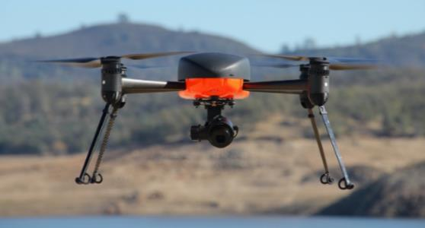
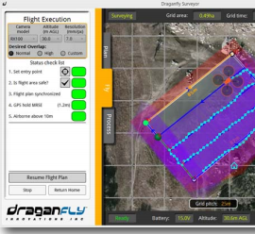
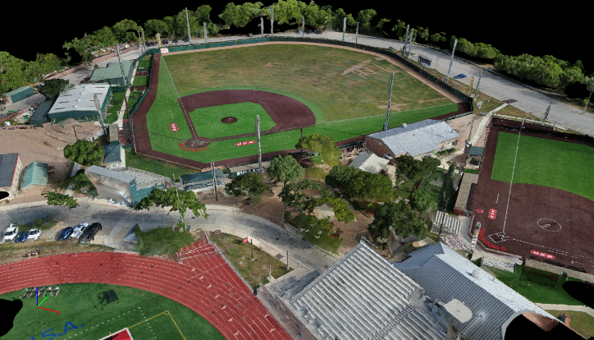
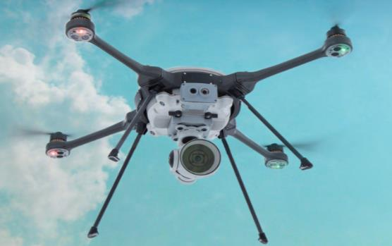
Flight Operations – FAA Part 107

Slide 17
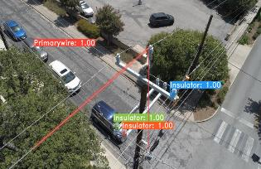
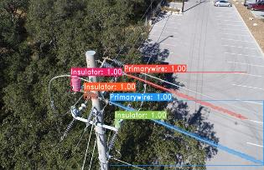
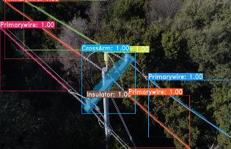
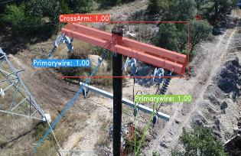
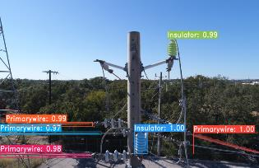
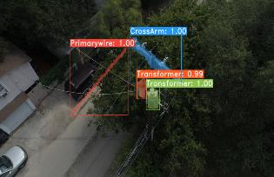
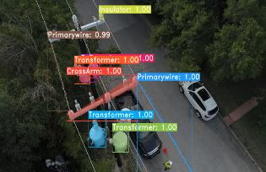
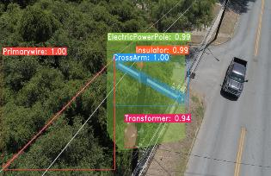
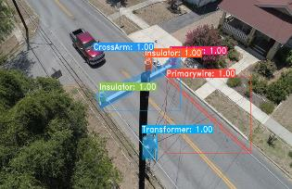
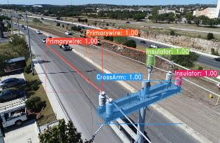
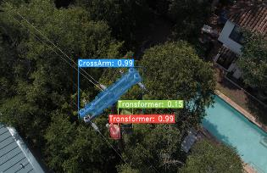
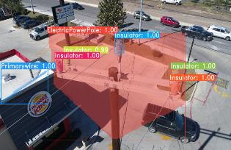
Outdoor Powerline Inspection System

Slide 18
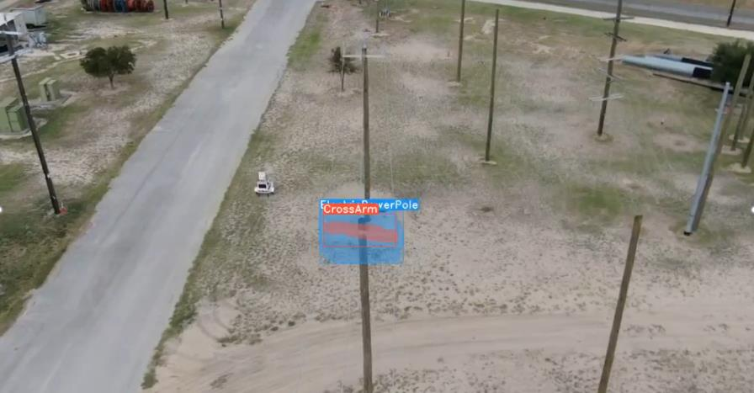
Unmanned Autonomous Aerial Vehicle (UAV)

Slide 19
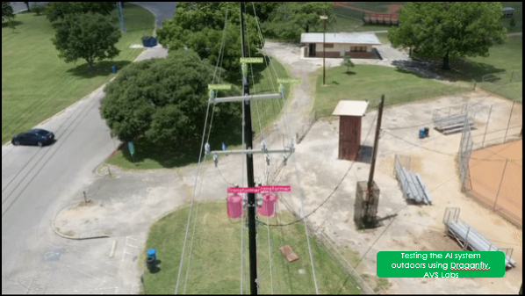
Future Work
Improves the efficiency
Eliminates the drawbacks associated with the UAV inspection such as
Battery life
Amount of area that can be inspected
Establish human-robotic teaming for using autonomous systems within the populous areas
Inspections fast and reliable
Future work: Outdoor testing
Testing the AI system outdoors using Draganfly, AVS Labs

Slide 20
Questions
THANK YOU
Srikanth Vemula vemula@uiwtx.edu
Jovany Avila joavila@uiwtx.edu
Dr. Michael Frye mfrye@uiwtx.edu

