Slide 1
SoSECIE Webinar
Welcome to the 2022 System of Systems Engineering Collaborators Information Exchange (SoSECIE)
We will start at 11AM Eastern Time
You can download today’s presentation from the SoSECIE Website:
https://mitre.tahoe.appsembler.com/blog
To add/remove yourself from the email list or suggest a future topic or
speaker, send an email to sosecie@mitre.org

Slide 2
NDIA System of Systems SE Committee
Mission
To provide a forum where government, industry, and academia can share lessons learned, promote best practices, address issues, and advocate systems engineering for Systems of Systems (SoS)
To identify successful strategies for applying systems engineering principles to systems engineering of SoS
Operating Practices
Face to face and virtual SoS Committee meetings are held in conjunction with NDIA SE Division meetings that occur in February, April, June, and August
NDIA SE Division SoS Committee Industry Chairs:
Mr. Rick Poel, Boeing
Ms. Jennie Horne, Raytheon
OSD Liaison:
Dr. Judith Dahmann, MITRE

Slide 3
Simple Rules of Engagement
I have muted all participant lines for this introduction and the briefing.
If you need to contact me during the briefing, send me an e-mail at sosecie@mitre.org.
Download the presentation so you can follow along on your own
We will hold all questions until the end:
I will start with questions submitted online via the CHAT window in Teams.
I will then take questions via telephone; State your name, organization, and question clearly.
If a question requires more discussion, the speaker(s) contact info is in the brief.

Slide 4
Disclaimer
MITRE and the NDIA makes no claims, promises or guarantees about the accuracy, completeness or adequacy of the contents of this presentation and expressly disclaims liability for errors and omissions in its contents.
No warranty of any kind, implied, expressed or statutory, including but not limited to the warranties of non-infringement of third-party rights, title, merchantability, fitness for a particular purpose and freedom from computer virus, is given with respect to the contents of this presentation or its hyperlinks to other Internet resources.
Reference in any presentation to any specific commercial products, processes, or services, or the use of any trade, firm or corporation name is for the information and convenience of the participants and subscribers, and does not constitute endorsement, recommendation, or favoring of any individual company, agency, or organizational entity.

Slide 5
2022 System of Systems Engineering Collaborators Information Exchange Webinars Sponsored by MITRE and NDIA SE Division
April 19, 2022
Feature-based Product Line Engineering in Aerospace and Defense
Charles Krueger
May 3, 2022
Cross-Domain Stakeholder-Alignment in Collaborative SoS – Lego Serious Play as a Boundary Object
Johann Shuetz, Julia Koehlke, and Sebastian Hanna
May 17, 2022
Mission-Level Optimization: A New Method for Designing Successful Systems
Brian Chell
June 14, 2022
Leverage Set-Based Practices to Make Agile Practices More Effective for System-of-Systems Engineering
Brian Kennedy
June 28, 2022
Model Based Systems Engineering in a Digital Environment: Creating a Virtual Testbed for Complex System Architectures
Claudeliah Roze
https://www.mitre.org/capabilities/systems-engineering/collaborations/system-of-systems-engineering-collaborators

Slide 6
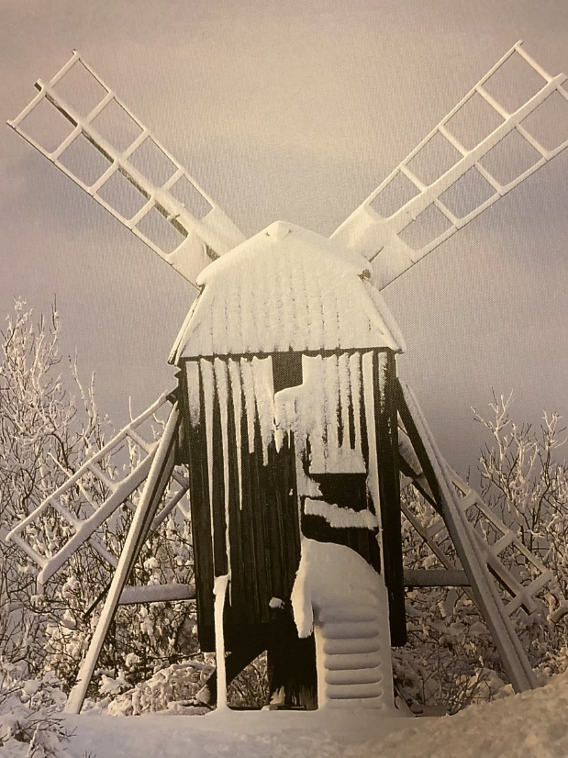
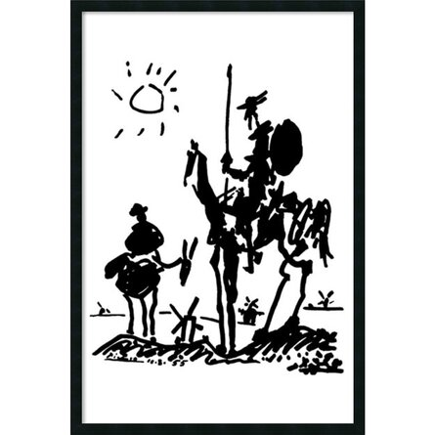
Tilting at Windmills: Drivers, Risk, Opportunity, Resilience and the 2021 Texas Electricity Grid Failure
Matthew Hause
Principal Systems Engineer
System Strategy, Inc
MHause@systemxi.com

Slide 7
Abstract
To put it very simply, but not at all clearly, the 2021 Texas electricity grid failure was both caused by and not caused by the use of renewable energy. In 2020, 46 percent of Texas's energy was generated by natural gas, coal 18 percent, nuclear 11 percent, and renewables wind power 23 percent, and solar 2 percent. During the winter months when power demand is lowest, renewables can rise to up to 55%. When the historic winter storms hit, the biggest problem was the lack of winterization of all types of generation systems and supporting infrastructure. All the of the systems failed to various degrees. So why weren’t these systems winterized? Mostly it was a lack of incentives. The government provided no financial incentives and did not mandate winterization. These winter storms were once in a century event, and companies could not make a business case with reasonable ROI to winterize. Companies that did manage to operate sold power and gas for up to 400% more than normal due to the lack of supply and increased demand. So, there was a built-in disincentive to not invest. What happened was a complex system of systems failure the size and scale of Texas and to explain it all would require a book. This paper will look at the risks, opportunities, and drivers of Texas electric grid, what caused it to fail, and incentives to succeed in the future. We will also examine incentive systems gone wrong such as the Cobra Effect.

Slide 8
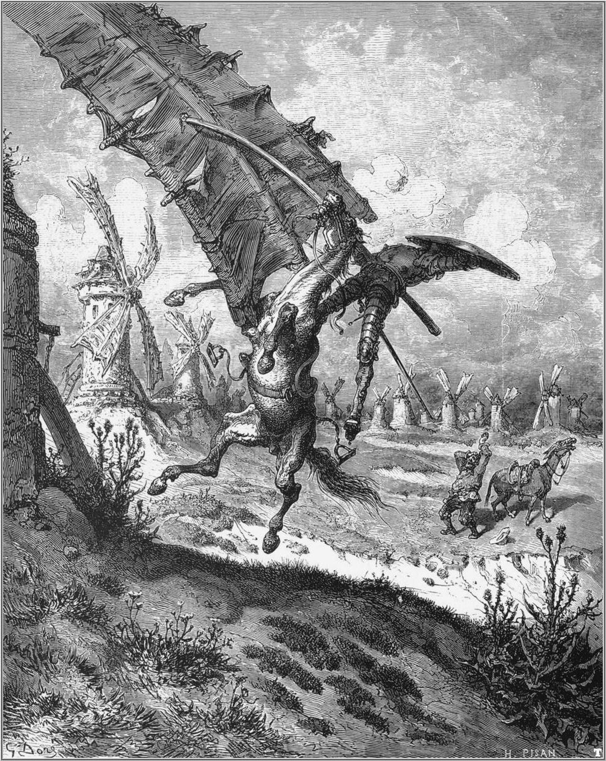
Agenda
What did happen
What didn’t happen
Incentives
Systems of Systems
UAF Overview
Mapping a strategy
What should happen next time
Future research
Conclusion

Slide 9
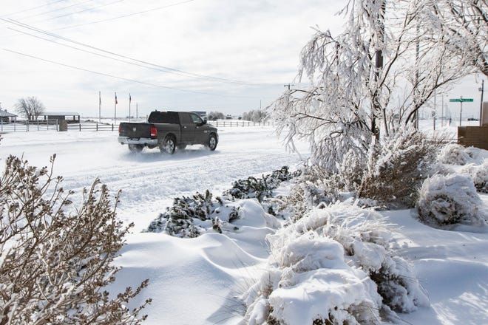
What Are the Facts?
Winter storm Uri hit Texas causing freezing temperatures.
Generators, and generator power sources (Coal, Gas, Nuclear, Water) failed
Loss of generation put the grid stability at risk
Load shedding to protect the grid cut off power from millions
Almost 300 people died, many homes and businesses destroyed.
The emergency lasted 4 days
Texas was not prepared.

Slide 10
What Are the Myths?
Overreliance on renewables was the major cause of the Texas Grid problems.
Renewable energy makes up only a fraction of the generating capacity.
Connecting the Texas Grid to the East or West Grid would have prevented the problem.
The Texas Grid is inherently unstable.
The grid failure was not foreseen.
Deregulation was a major cause of the failure.

Slide 11
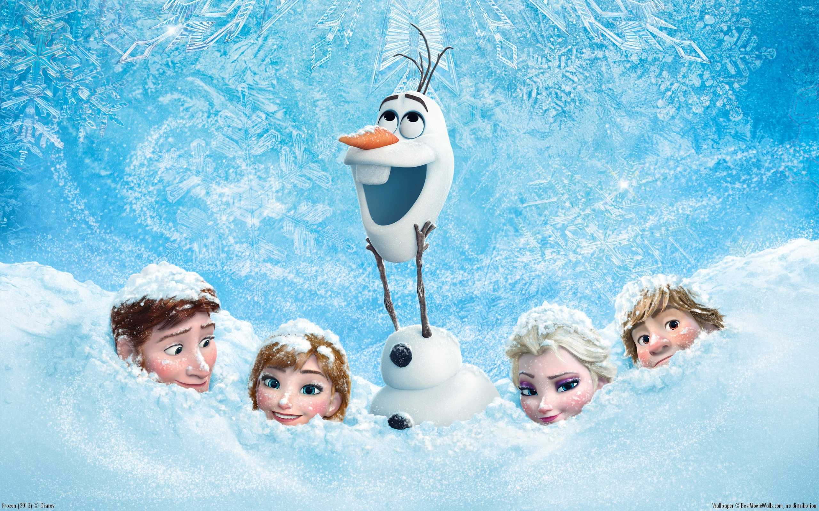
What Really Caused the Failure?
Texas infrastructure not prepared for an extended and unusual cold snap.
Fossil Fuel Generation: gas generators, coal generators
Clean Generation: nuclear generators, wind turbines, solar
Supporting Infrastructure: gas drilling, gas distribution, water supplies
Buildings: houses, apartments, stores, hotels, office buildings, etc.
Transportation: roads, trains, buses, cars, trucking, etc.
Everything froze.
Gas supplies froze limiting gas generation
Houses needed gas, further limiting supplies
Prices rose causing gas generators to shut down
Water supplies froze limiting nuclear, coal & gas
Demand exceeded supply
ERCOT mandated load-shedding to maintain critical services, hospitals, fire, etc.
Power was cut off to millions of homes & businesses

Slide 12
Why Weren’t the Systems Winterized?
There was insufficient incentive and ROI to do so
Winterization of infrastructure was not mandated by the government.
Similar cold snaps happen roughly every 40 years
The initial investment and maintenance for winterization is expensive
There was no effective business case to winterize unless required
The same reasoning was universally applied
Homes, businesses, infrastructure, apartments, condominiums, etc.
Preparation for the next storm needs to be driven by both business and engineering.
So, how to express these concepts?

Slide 13
Systems of Systems
Definition: A system of systems (SoS) is "a collection of systems, each capable of independent operation, that interoperate together to achieve additional desired capabilities.“ (Mitre)
Maier (1998) postulated five key characteristics of SoS:
operational independence of component systems
managerial independence of component systems
geographical distribution
emergent behavior, and
evolutionary development processes
Other aspects
Have multiple levels of stakeholders with mixed and possibly competing interests
Have multiple, and possibly contradictory, objectives and purpose
Have multiple, different, operational priorities with no clear escalation routes
Have multiple lifecycles with elements being implemented asynchronously
Have multiple owners making independent resourcing decisions
?
?!
?
?!
@
!!

Slide 14
The Electric Grid as an SoS
Operational independence
The Texas Energy SoS is operated by entities. They are a collection of independent operators, government institutions, municipal companies, and not for profit agencies. They operate independently to support their individual customers. Support of the overall is of secondary importance.
Managerial independence
Each of the grid entities must comply with a variety of different standards, rules, laws and regulations. The Electric Reliability Council of Texas (ERCOT) oversees energy companies. However, they maintain their operational independence separate from that of the grid.
Evolutionary development
New systems, technologies or ConOps may be introduced by any of the companies as required to evolve and adapt to the changing environment, latest technology needs or stakeholder requirements. This will affect both the individual system as well as the SoS.
Geographical distribution
The Texas power grid is geographically distributed by its very definition.
Lifecycle independence
Even within the individual companies there will be multiple system lifecycles across asynchronous acquisition and development efforts, involving legacy systems, developmental systems, and technology insertion to meet their customer needs.

Slide 15
Types of SoS
Directed
SoS is created and managed to fulfill specific purposes.
Constituent systems are subordinate
Airports, Air Traffic Management, etc.
Acknowledged
Recognized objectives, a designated manager, and resources.
Systems retain their independence.
Changes are based on cooperative agreements
Defense systems, governments, etc.
Collaborative
Component systems interact voluntarily to fulfill central purposes.
Public utilities, Cell phone network, Cable TV, Texas Energy Grid and supporting systems
Virtual (Basically, the internet)
No central management authority or centrally agreed upon purpose.
Invisible mechanisms maintain it.
(Maier, 1998; Dahmann and Baldwin, 2008, ISO 21839, 2019):
?
?!
?
?!
@
!!

Slide 16
Importance of the SoS to the Texas Grid
Multiple levels of stakeholders
Changes cannot simply be mandated but must be negotiated.
Changes will take time to negotiate and implement
Multiple, and contradictory, objectives and purpose
There is no “Common Good”. Benefits for one will adversely affect others
Proposed changes will cause infighting delaying implementation
Multiple, different, operational priorities
Systems must be taken offline for winterization, affecting income
Owners, stakeholders, shareholders, customers, regulators must be consulted
Multiple System lifecycles
Peak electric is in the summer, gas in the winter, water in the summer
ROI to replace newly installed systems is difficult
Multiple owners making independent resourcing decisions
Deregulation has cut operating margins limiting discretionary funds
Government will need to supplement, not traditionally a major government priority in Texas
?
?!
?
?!
@
!!

Slide 17
Model-Based Systems Engineering
Model-based Systems Engineering (MBSE) is the formalized application of modeling to support system requirements, design, analysis, verification, and validation activities beginning in the conceptual design phase and continuing through-out development and later lifecycle phases.” (INCOSE, 2007).
Modeling is at the heart of all aspects of the development effort
Covers the complete product and project lifecycle
Has a direct effect on any generated artifacts.
MBE encompasses architecture, systems and software development.

Slide 18
Achieving Desired Outcomes Using Enterprise Architecture & Architecture Frameworks
Drivers
Demand
Competition
Laws
Regulations
People
Technology
Investment
Revenues
Enterprise State
Outcomes
Products
Services
Revenues
Earnings
Share Price
Market Share
Jobs
Innovation
Work Processes

Slide 19
Unified Architecture Framework (UAF)
The UAF is used for defining system architectures and system of systems architectures
It is focused on the scope, needs, strategy, expectations, stakeholders, and long-term plans
It is built on SysML, so has built-in traceability to system development in SysML.
Great for large organizations to figure out what they are doing and why.

Slide 20
The UAF Grid
Standard means of expression – model kinds
 | Taxonomy | Structure & Connectivity | Behavior | Information | Parameters | Constraints | Roadmap | Traceability
Strategic
Operational
Services
Personnel & Resources
Security
Projects
Standards
Requirements
Data in all forms
As-Is
To-Be
Planning
Continuous
Availability
Business View, Identifying, Monetizing, Informing
Usage View, Understanding the SoS from Operational Perspective
Functional View, Disruption Identifying Cognitive Services
Different Domains
Implementation View, Cloud, Analytics and Edge Architecture, Interfaces, Behavior
Traceability across all levels
Cyber Security Analysis
Understand project development milestones
Standards compliance

Slide 21
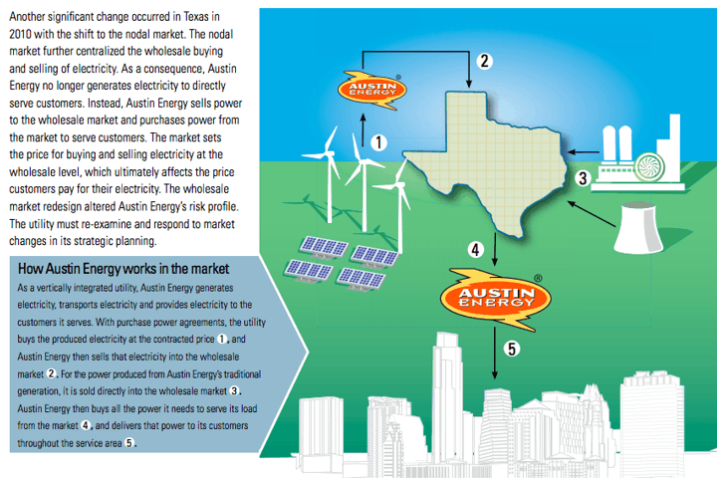
Example Problem: Austin Energy
Austin Energy is a vertically integrated utility
AE Generates power
Sells to the wholesale market
Wholesaler sets the price
AE buys back needed power
AE distributes to its customers

Slide 22
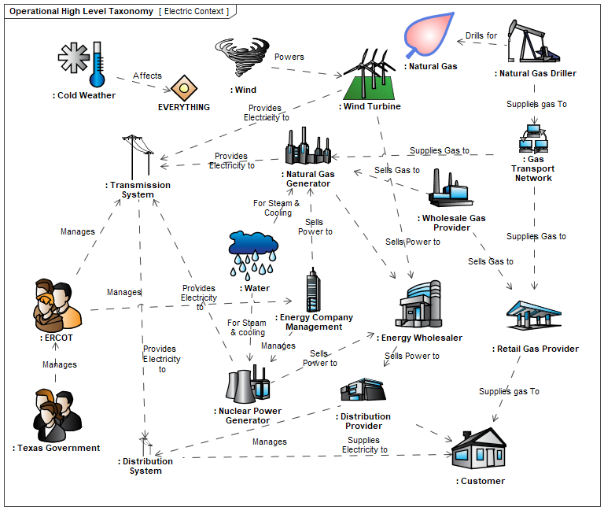
High Level Concept Diagram
Generic diagram communicating concepts
Shows conceptual relationships between entities
Used to communicate with stakeholders

Slide 23
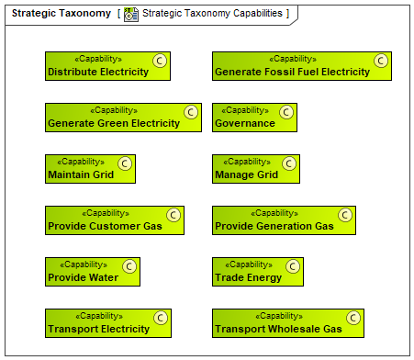
Energy Grid System of Systems Capabilities
Capabilities define what the enterprise can accomplish without specifying how
Enable desired effects and outcomes (Later)
Define purpose of the enterprise
Capabilities are realized by systems (Next)

Slide 24
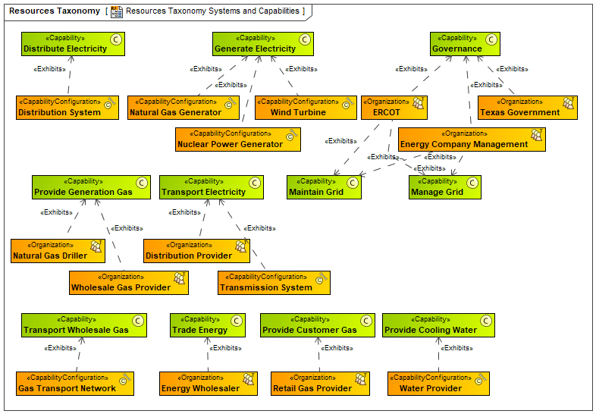
Capabilities and Implementing Resources
Systems implement the capability by creating the desired effects
Multiple systems implement a capability
Capabilities and systems depend on one another

Slide 25
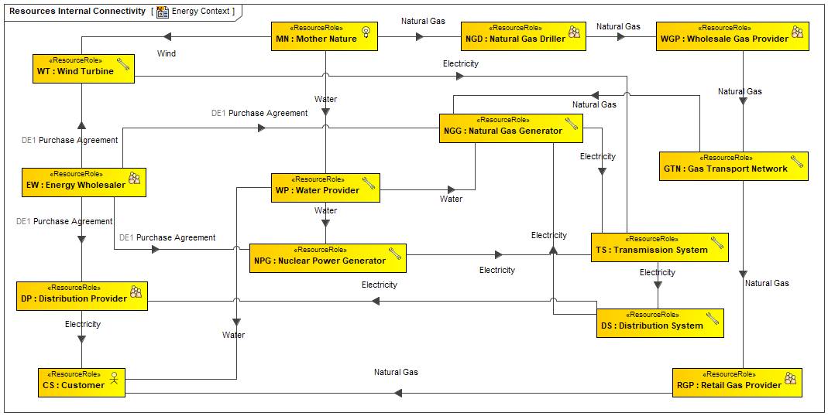
Energy System Architecture
System connections and flows
Demonstrates the interconnected-ness of the systems
Failure of any connection will ultimately affect everything

Slide 26
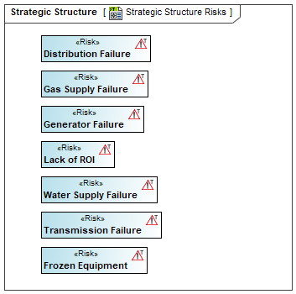
Energy System Risks
Risk: The chance or probability that an adverse event will occur. Risk analysis examines probability of risk as well as the adverse effect.

Slide 27
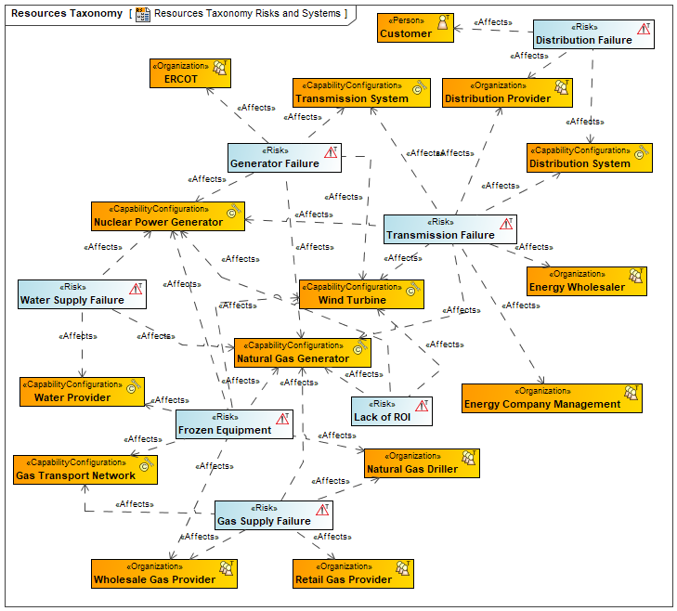
Risks and Affected Resources
System Risks and elements they affect
Gas supply failure affects Generation, Transportation, Wholesales, Retail, Driller and Customer.
Frozen Equipment affects almost everything
Lack of ROI affects generation infrastructure
So, can we mitigate these risks?

Slide 28
Winterization is Now Mandated
On June 8, 2021, Texas Governor Greg Abbott signed Senate Bill 2 and Senate Bill 3 to reform the Electric Reliability Council of Texas (ERCOT). "A top priority that we had this legislative session was to fix the power to prevent any other power grid failure in the future," "The legislature passed comprehensive reforms to fix all of the flaws that led to the power failure. "Senate Bill 3 (SB3) requires electricity providers operating on the ERCOT grid to weatherize their equipment and improve communication during outages by creating an alert system. Abbott said the new legislation targeted weather for all seasons. (Fung, 2021)
So, how does this change the business case?
What systems are affected?
How does this change the architecture?
How do we demonstrate ROI on winterization?
How do we model this?

Slide 29
Definition of Concepts
Concept | Definition
Driver* |  | Thing that forces us to work or act; that which urges you forward
Challenge* |  | A demanding or stimulating situation; a call to engage in a contest or fight
Enterprise State* |  | Condition with respect to circumstances or attributes
Capability |  | Ability to do something under particular conditions and environments, to achieve a desired effect.
Opportunity* |  | A possibility due to a favorable combination of circumstances
Risk* |  | A source of danger; a possibility of incurring loss or misfortune
Effect |  | A phenomenon that follows and is caused by some previous phenomenon
Outcome* |  | Something that happens or is produced as the final consequence or product

Slide 30
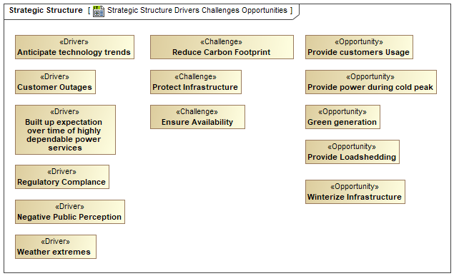
Strategic Motivation Diagram
Drivers present Challenges to the enterprise
Challenges are conditions that can be addressed by Opportunities
Each Opportunity can present the circumstances for new Risks to the Enterprise
Existing or new Capabilities can help the enterprise pursue these Opportunities

Slide 31
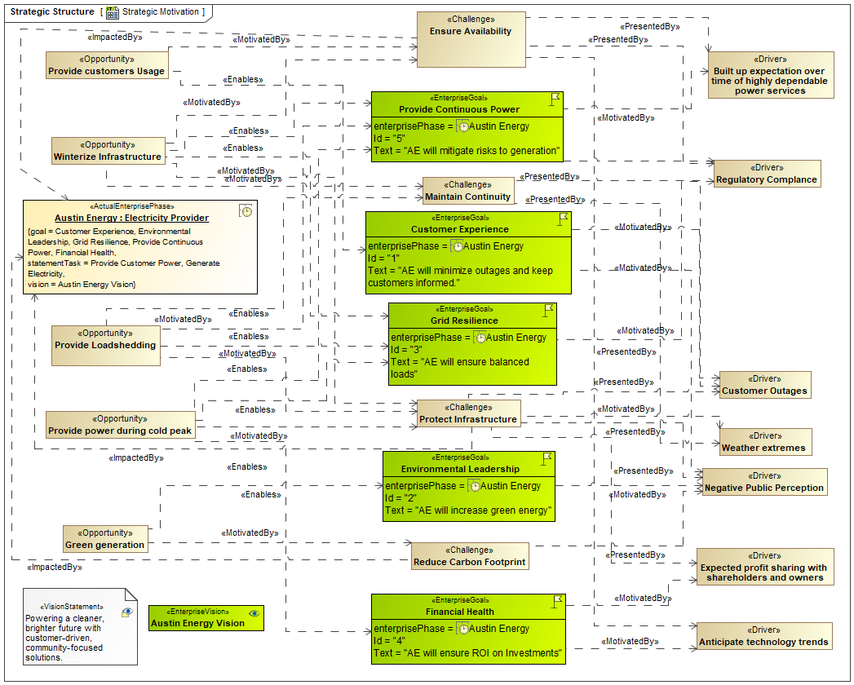
Strategic Motivation Diagram

Slide 32
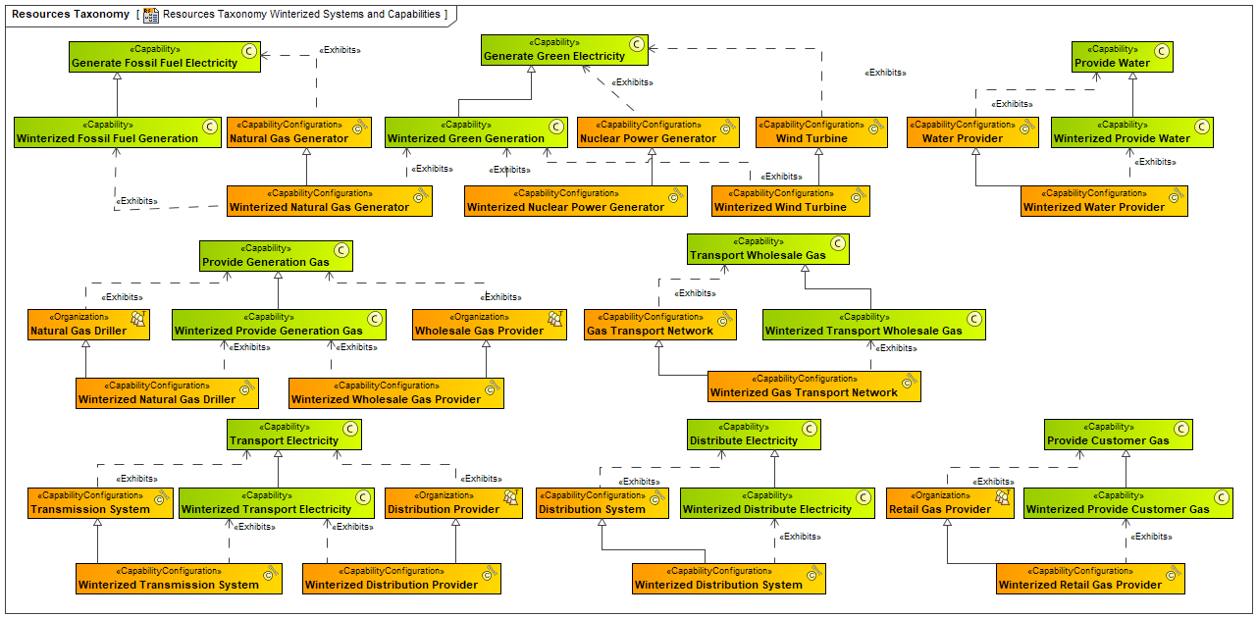
Winterized Capabilities & Resources

Slide 33
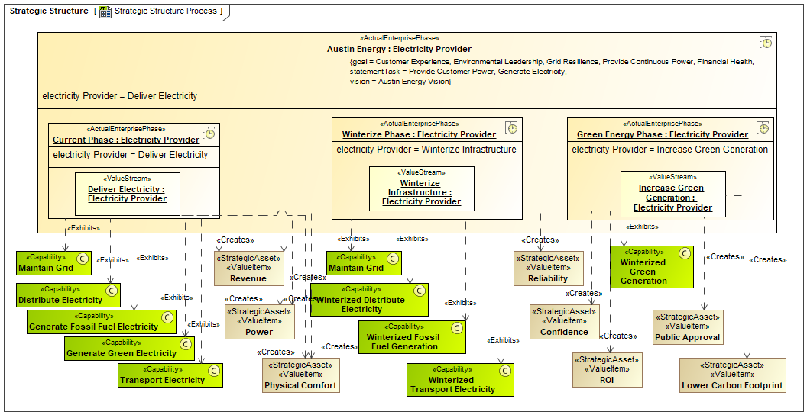
Strategic Structure Diagram

Slide 34
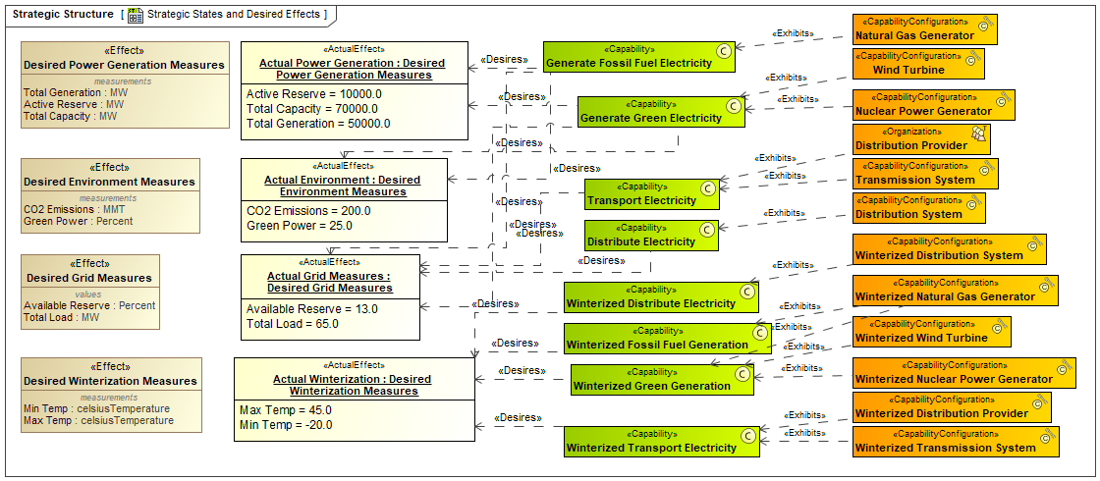
Strategic States Diagram (Effects)

Slide 35
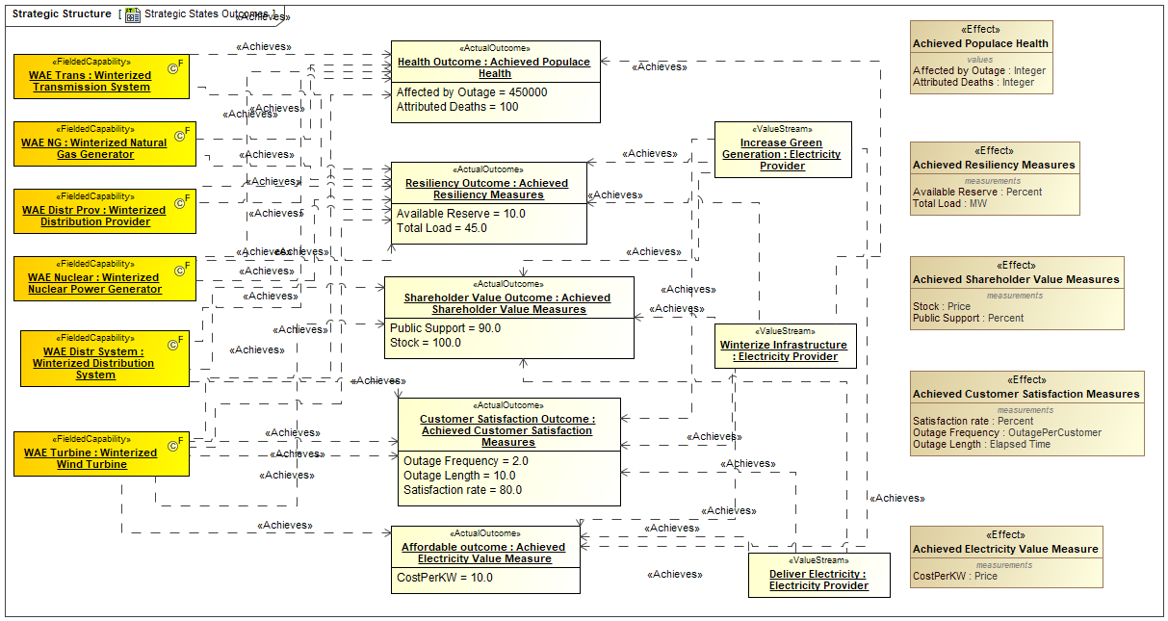
Strategic States Diagram (Outcomes)

Slide 36
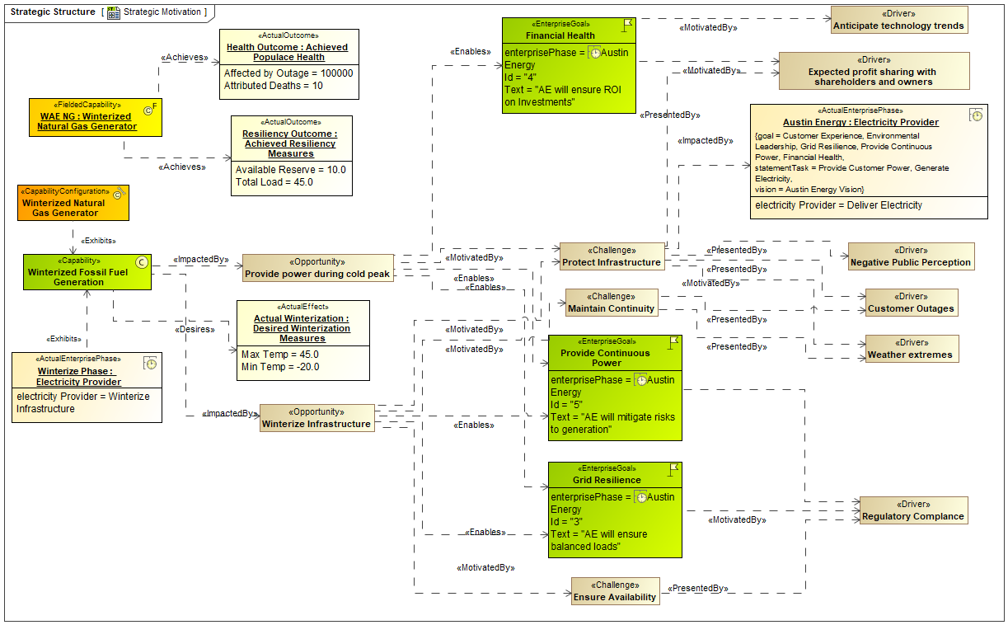

Slide 37
Model Simulation – Sunny Day
What Texas Expected to Happen
Electric generator is down for maintenance
Crisis happens
ERCOT starts raising power price
Eventually the price gets high enough to make it worth it for the electric generator to abort the maintenance cycle and start generating
Crisis averted
Happy, happy, happy

